Slide 1
Achieving Your Career Goals by Developing Your Leadership Path
Michael Allington, Binghamton University
Stephen Cook, SUNY Brockport
Timothy Cortesi, Binghamton University
Laurie Fox, SUNY Geneseo

Slide 2
Agenda
1 | Introductions
2 | Career Overviews
3 | Questions / Answers

Slide 3
Introductions

Slide 4
Individual Career Paths

Slide 5
Michael Allington

Slide 6
Michael Allington

Slide 7
Michael Allington

Slide 8
Michael Allington

Slide 9
Mike’s Lessons Learned
When an opportunity is presented, take it!
Learn something new every day.
Take risks, but don’t be reckless.
Don’t be afraid to share your knowledge.
Find a mentor.

Slide 10
Stephen Cook
SUNY Brockport
Student Affairs and Higher Education

Slide 11
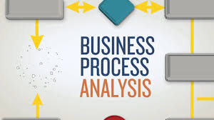
Stephen Cook
SUNY Brockport

Slide 12
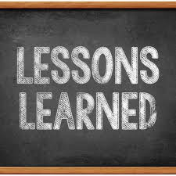
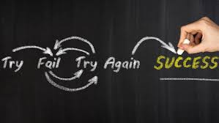
Stephen Cook
SUNY Brockport

Slide 13
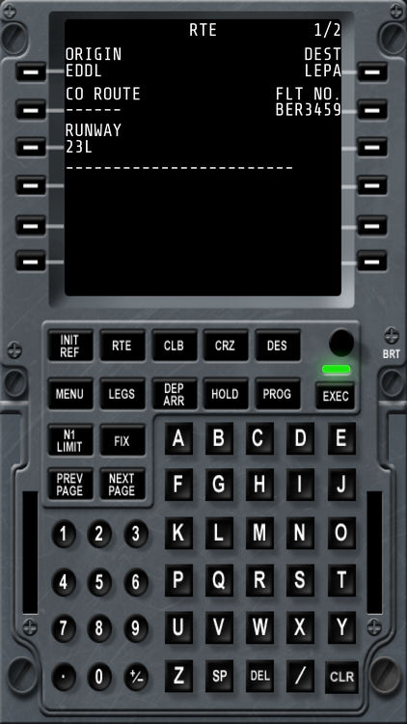
Tim Cortesi

Slide 14
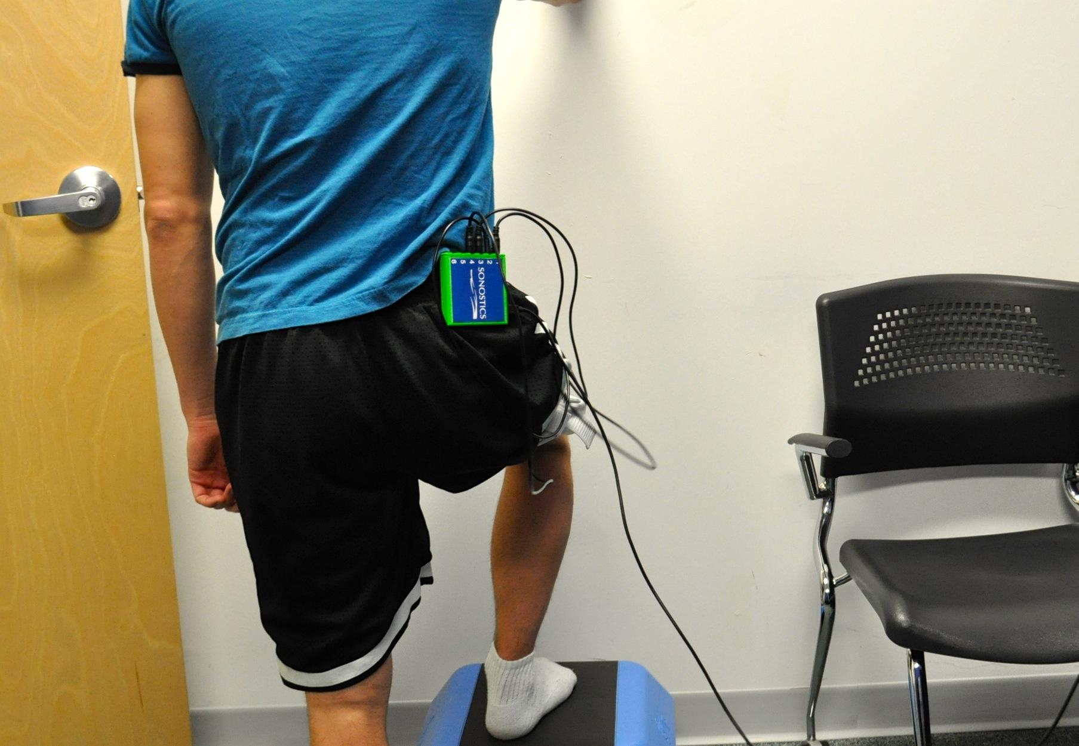
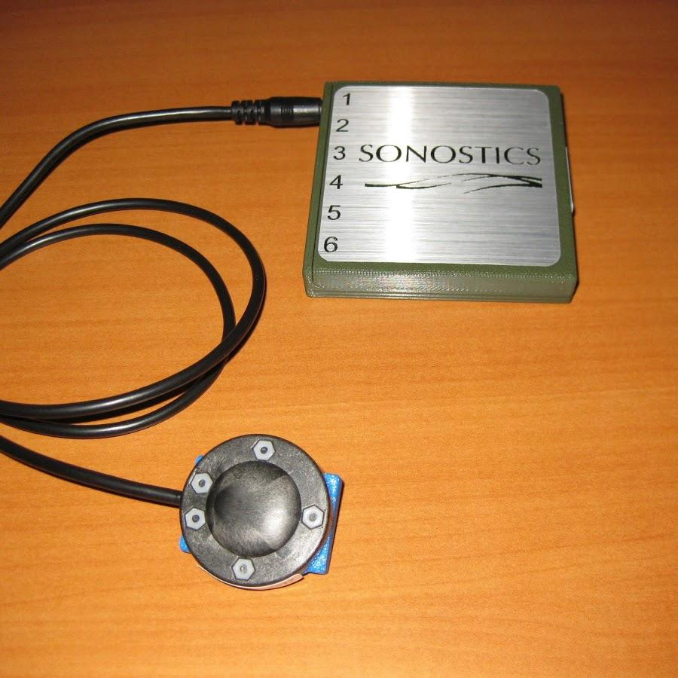
Tim Cortesi

Slide 15
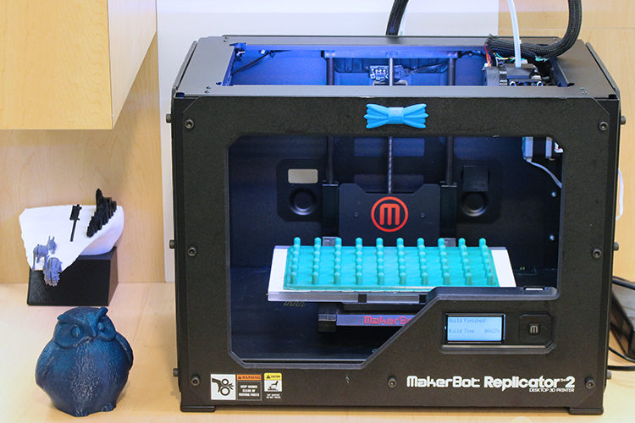
Tim Cortesi

Slide 16
Tim Cortesi’s “Lessons Learned”
Make Yourself Useful
Know What You Want, and Actively Pursue It
Learn How To Estimate (time)
Become An Expert
Know Your Value
Don’t Be Afraid To Bail

Slide 17
Laurie Fox

Slide 18
General Takeaways

Slide 19
Questions & Answers

