Slide 1
Multi-Factor Authentication at SUNY
SUNY Technology Conference – 2019

Slide 2
Goals
Expand MFA throughout SUNY.
Learn from each other what we’ve done, what challenges we’ve faced, and how we’ve overcome them.

Slide 3


Slide 4
Current MFA users
Who is using MFA?
What populations are you protecting?
What applications are you protecting?

Slide 5
Resistance
From administration
From purchasing/procurement
From faculty/staff
From students

Slide 6
MFA device usage
At New Paltz – we only support (for now) Duo via the iOS/Android apps, or the Duo hardware tokens.
Current stats:
  79.3% app usage (80% for faculty, 77.6% for staff)
  19% token usage (16.8% for faculty, 21.4% for staff)
  1.61% with both
Notes:
Why buys the hardware?

Slide 7
Onboarding
How and when do you get your students/faculty/staff on-board?
What on-boarding challenges do you have?

Slide 8
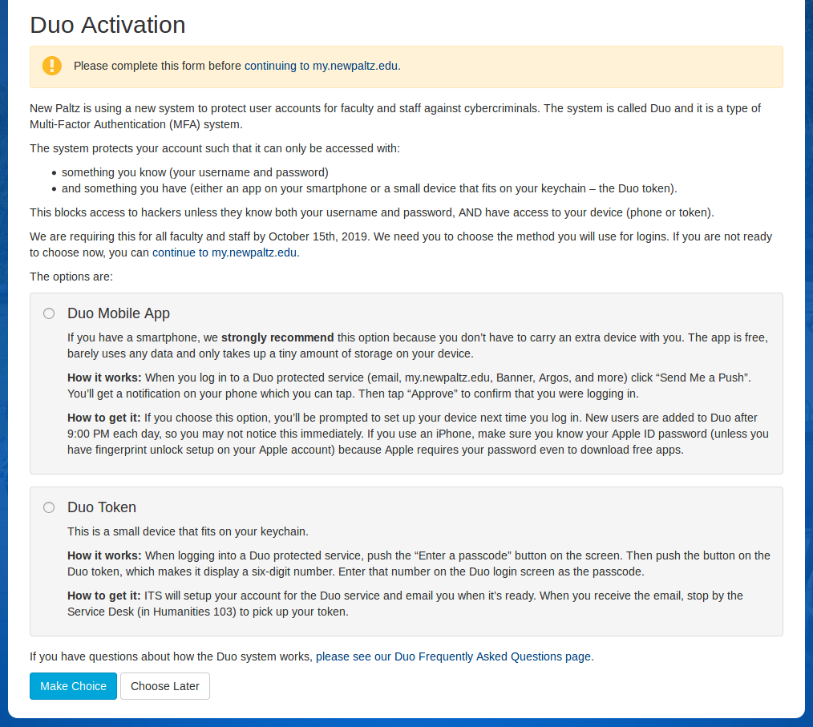

Slide 9
Device reactivation and lost/stolen device issues

Slide 10
Identity Verification

Slide 11
Application Integration

Slide 12
Other challenges

Slide 13
“If you think technology can solve your security problems, then you don’t understand the problems and you don’t understand the technology.” - Bruce Schneier
Notes:
I’m sure like many – you are looking at enhancing security with MFA. And it is definitely a good protection. There are human problems in rollout – and human problems which won’t be dealt with by MFA (especially with newer attacks).

