Slide 1
Using Data to Understand How Computer Labs Are Used Across Campus
Melaine Kenyon & Roland Rachinger

Slide 2
Presentation Outline
Definitions
Using K2 - KeyServer
Data Collection Method
Data Results
Future Planning

Slide 3
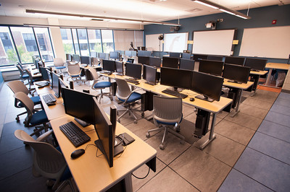
Definitions
A computer lab is a space with more than one computer for student use.

Slide 4
Definitions
A classroom instructional lab is a space with more than one computer for student use AND installed audio/visual presentation equipment.
37 labs with this definition.
3 scheduled by Registrar
34 scheduled by academic department

Slide 5
Definitions
A department lab is a space with more than one computer for student use. Usually restricted to students in a specific major, department or school.
Scheduled by the academic department.
86 labs with this definition.

Slide 6
Definitions
An open lab is a space with more than one computer for student use. Available to entire student population.
Two labs with this definition both located in Butler Library.

Slide 7
Why do our students use computer labs?
Notes:
Added Q to 2018 SOS survey

Slide 8
Throw out the assumptions! Collect data.
First reviewed computer lab use in 2013-2014
Sample of 22 lab spaces
Found most labs have additional capacity for use
Results indicated we could improve scheduling and student access
IT continues to receive requests for new computer labs
Several computer labs have been added during new construction and renovation
Current issues - budget challenges and cost control
Notes:
“everyone” assumes we need more computer labs as they can’t find a lab when they “want” one.
How many labs are there? 212
37 classroom instructional labs
86 department labs
38 faculty research labs
2 open labs
42 other spaces with computers in dorms, etc.

Slide 9
Using K2 for data
Using K2 since January of 2007
K2 is one of our primary asset management tools
Accuracy (via automation) of data, locations, computers
Physical audits

Slide 10
Using K2 for data – Our process
First devices are created in Team Dynamix (ticketing and workflow system)
Then device is imaged with SCCM/JAMF
K2 agent automatically installed during imaging process
With AD Client Authentication divisions are automatically created based on AD OU's

Slide 11
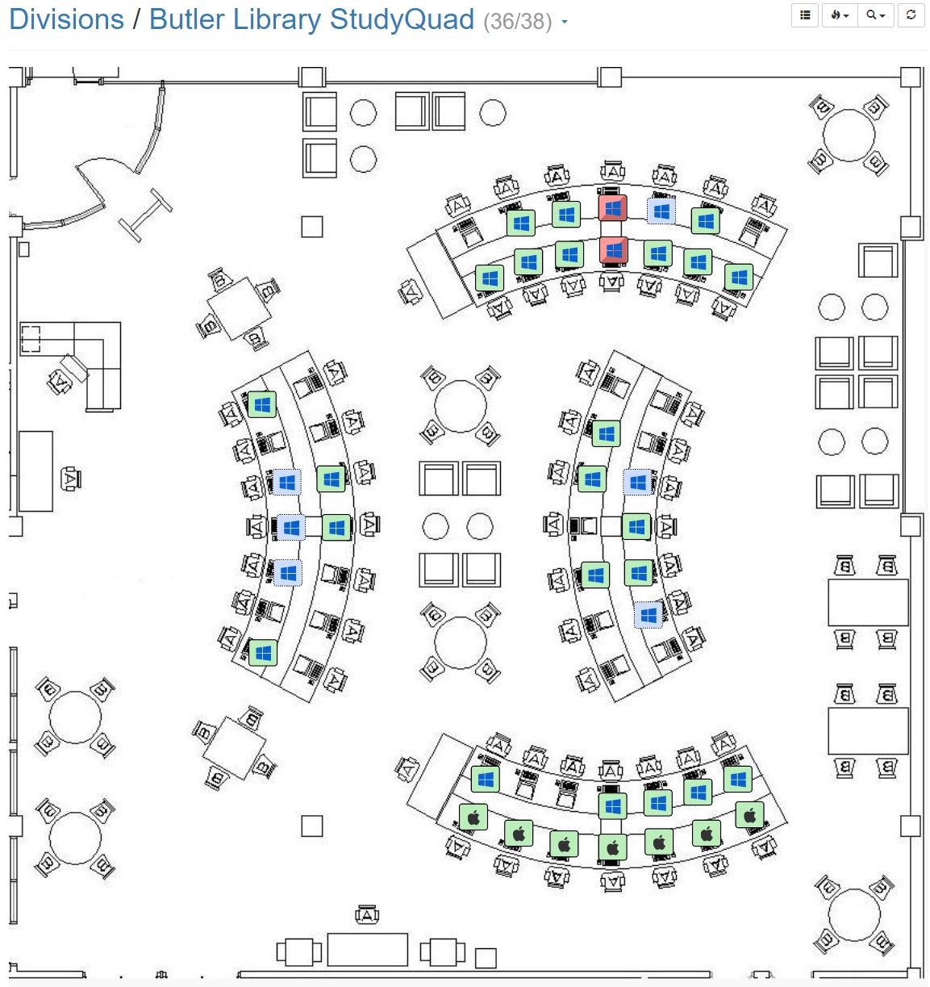
K2 Lab Maps
https://keyserver.buffalostate.edu/maps/std/96425bbfba391f49b5397dfd9d9a3e26?edit=1&mapped=1

Slide 12
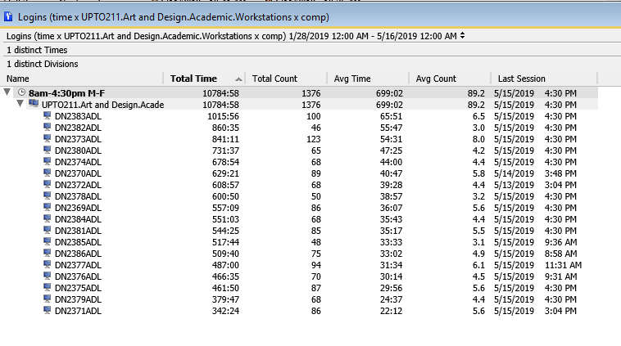
K2 data report example
Notes:
For the charts to make sense, need to share how we define our spaces, where our data comes from, how we collected it, etc.
better understanding of how and when computer labs are being used

Slide 13
Easy to run reports
Notes:
How are divisions selected? Chosen?

Slide 14
Collecting data
Data Sources
Computer lab list / computer inventory
Banner Master File
Academic Calendar
Sassafras K2 computer lab reports
August 27 – December 13, 2018 (73 days)
Monday – Friday
8:00 am – 10:00 pm (14 hours per day)
Notes:
Data Sources
Computer lab list / computer inventory
Banner Master File
Academic Calendar
Sassafras K2 computer lab reports
August 27 – December 13, 2018 (73 days)
Monday – Friday
8:00 am – 10:00 pm (14 hours per day)

Slide 15
Measuring Available Use
73 days in semester
1,022 hours available per computer
Number of computers in lab
14 hours per day
Total available hours for use

Slide 16
Results - Top 5 Most Used Labs
Notes:
57 total spaces
37 classroom instructional labs
18 department labs
2 open labs
Limited to labs with 6 or more computers
Excluded labs in dorms, advising areas, and offices such as Career Development and Writing Center
Excluded faculty research labs

Slide 17
Results - Least Used Labs
Notes:
Although scheduled for classes, low use of the computers.

Slide 18
Results – Classroom Instructional Labs
Notes:
Using K2, we can tell the average use @28%

Slide 19
Results – Registrar Scheduled Labs

Slide 20
Results – Department Labs
Notes:
Using K2, we can tell our academic department labs are not used to their full potential.

Slide 21
Results – Instructional Hours and Total Computer Use

Slide 22
Results – Unique Users in Butler Library Labs

Slide 23
Forecast for future
Further review - Extended moratorium on new computer labs
Gather and analyze data on utilization for rightsizing
Review software use
Begin to rightsize – Reduce the number of computers in certain labs
Plan with academic departments
Cost savings
Notes:
K2 Technical Services & Support for 4600 clients (1/25/2018-1/24/2019) $ 9,070.00 Cost of K2 is less than 10K annually for 4600 clients

