Slide 1
The Evolution of a Service Desk
Ryan Swan
Ryan.Swan@Oneonta.edu

Slide 2
Background:
Phone support 8am-9pm with 3 workstations
Printer/Lab support 8am-9pm with 2 workstations
Equipment loan- (laptops, ppt clickers, projectors, etc.)
Walk-in support
Software installs/support
Network device registration, troubleshooting
Level 1 support
Central point of contact between ITServices and our customers

Slide 3
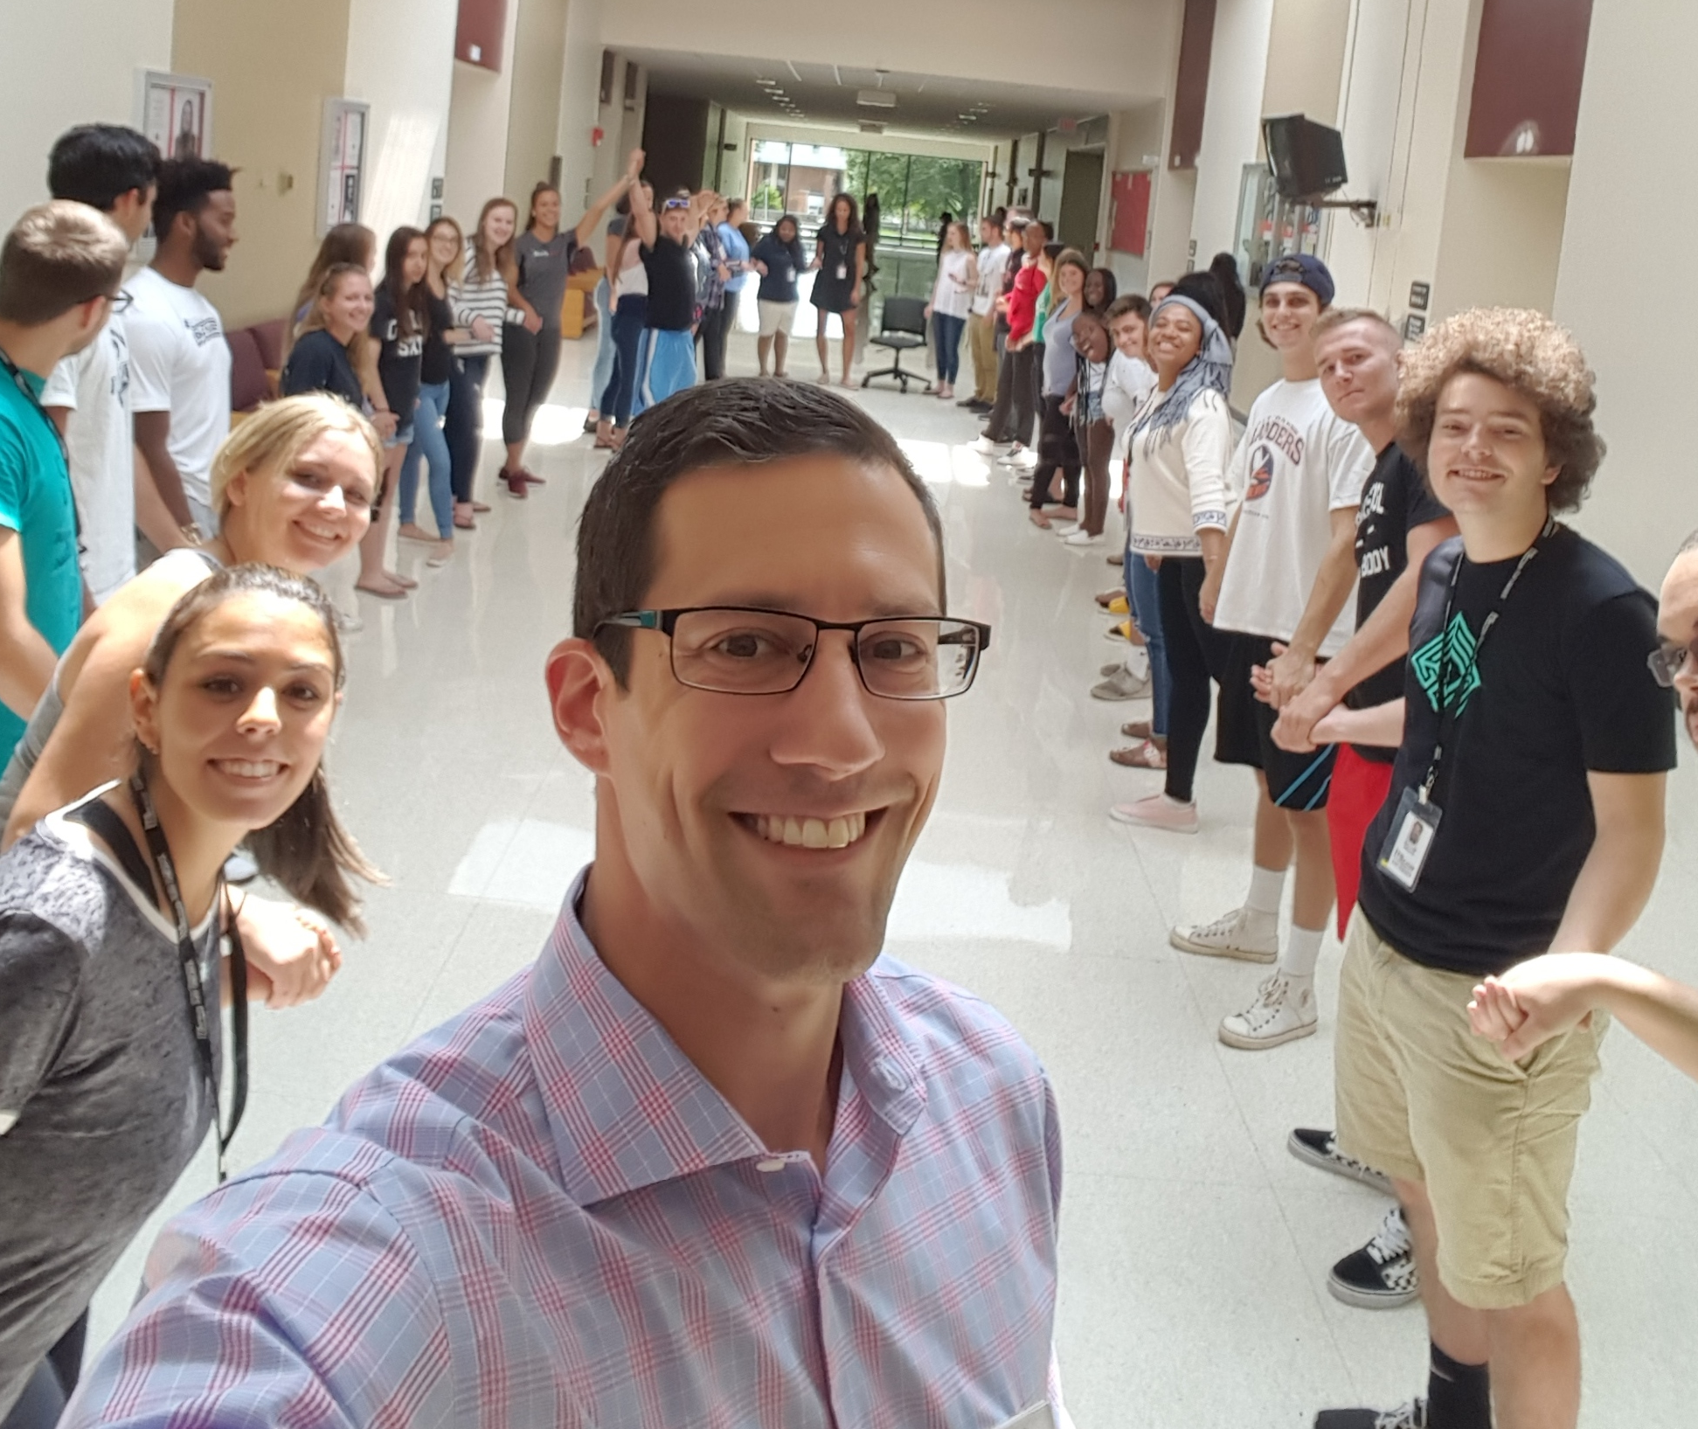

Slide 4
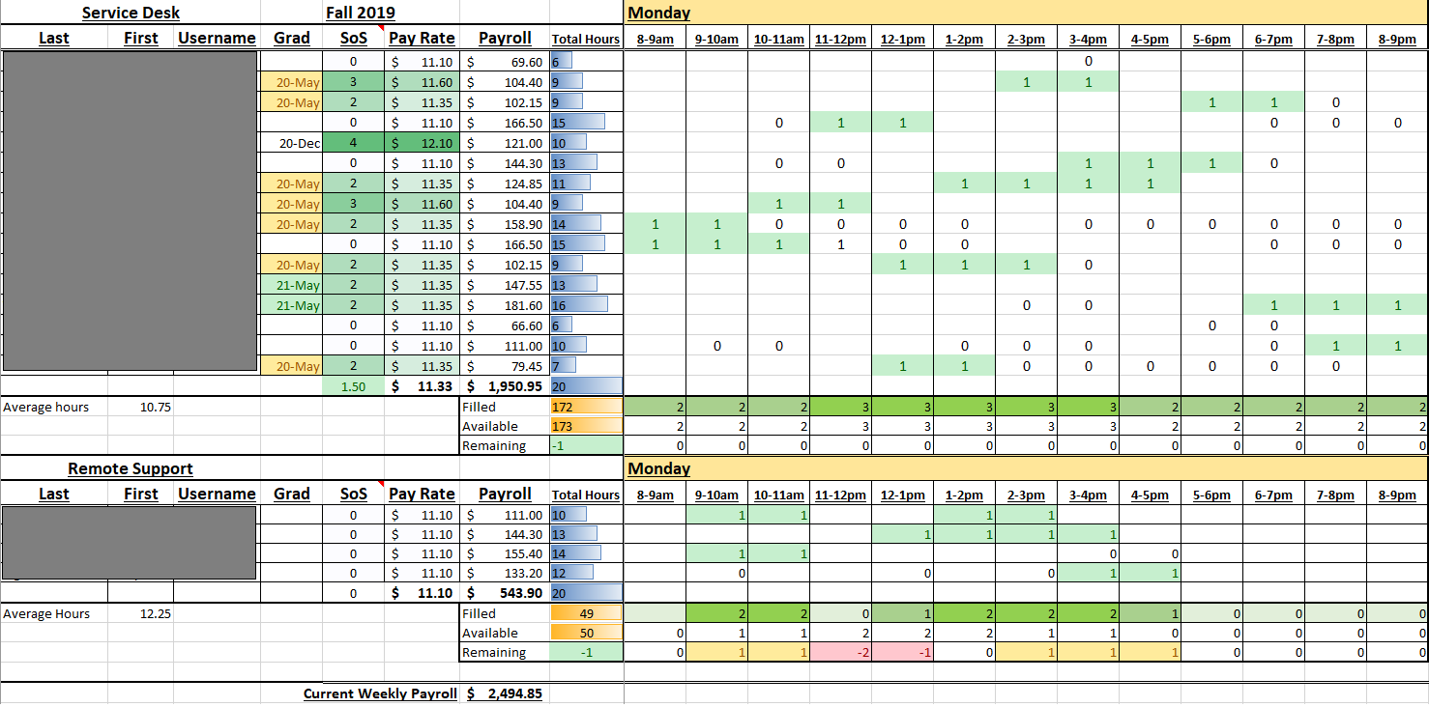

Slide 5
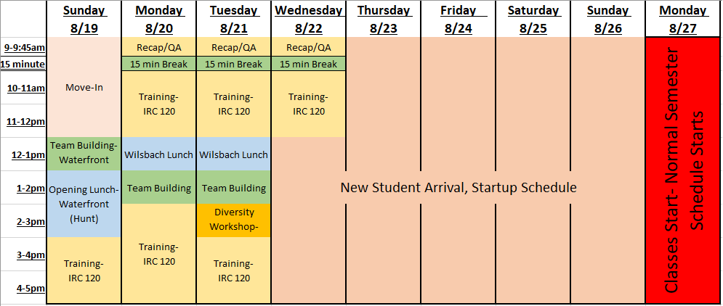
Fall 2018 Training Schedule

Slide 6
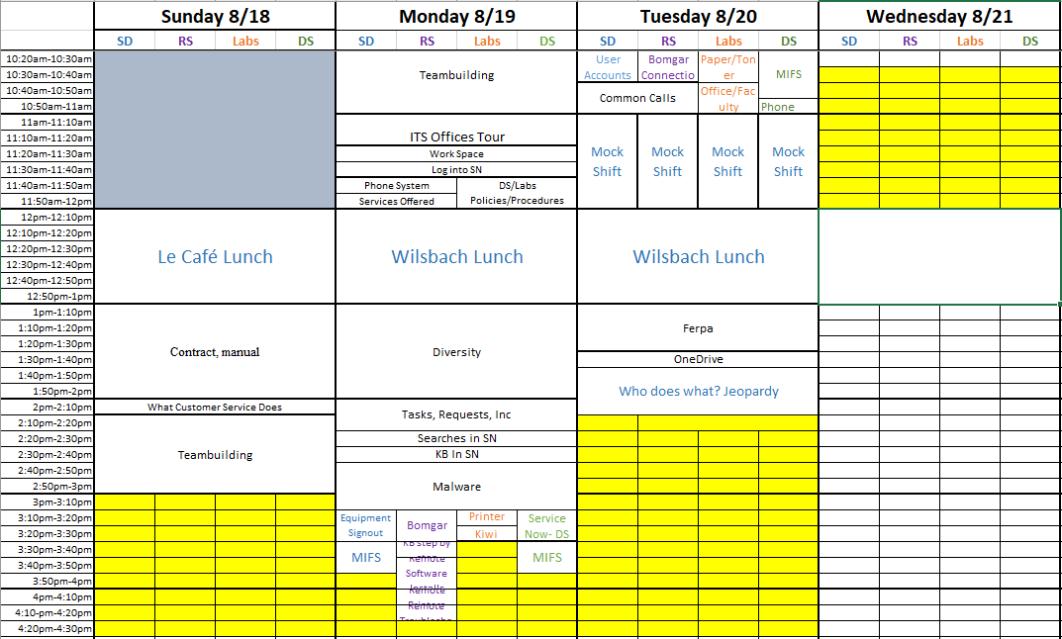
Fall 2019 Training Schedule (work in progress)

Slide 7
Student Assessment

Slide 8
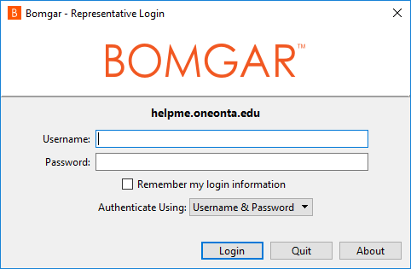
Remote Support Desk
Coming Fall 2019!

Slide 9
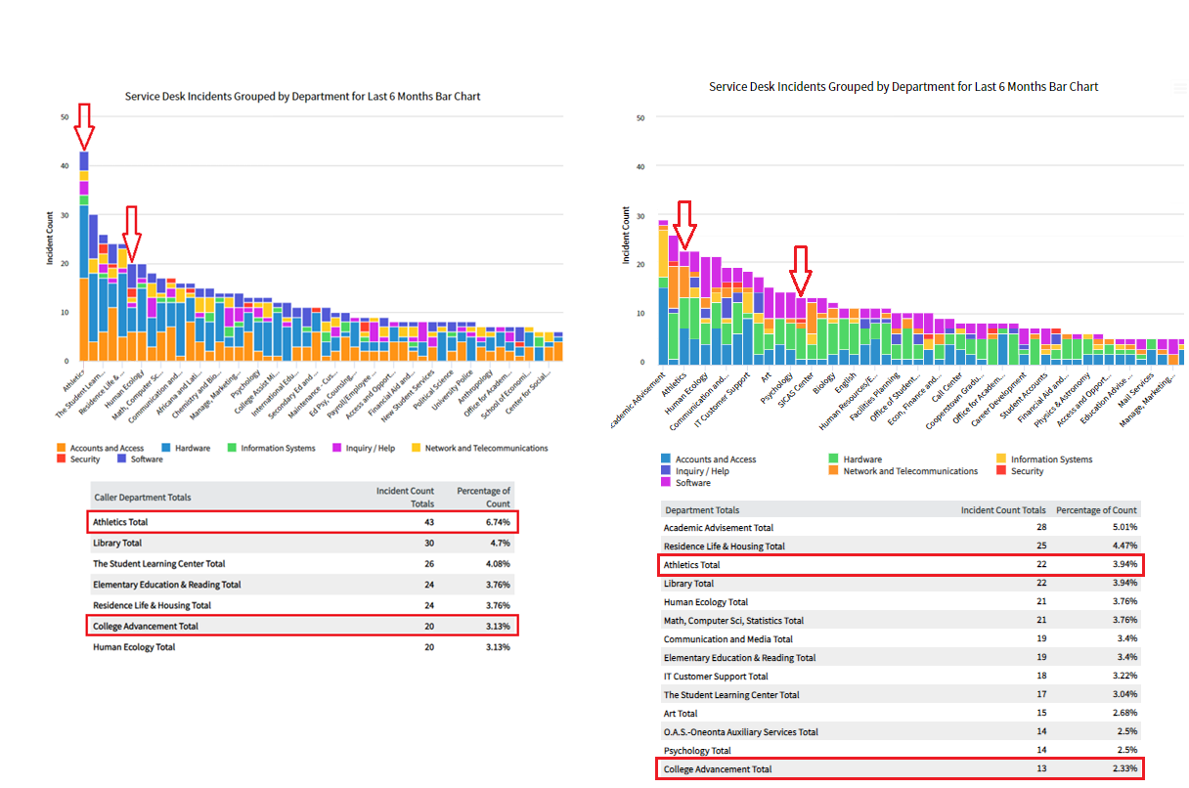
2018 Incidents:
2019 Incidents:

Slide 10
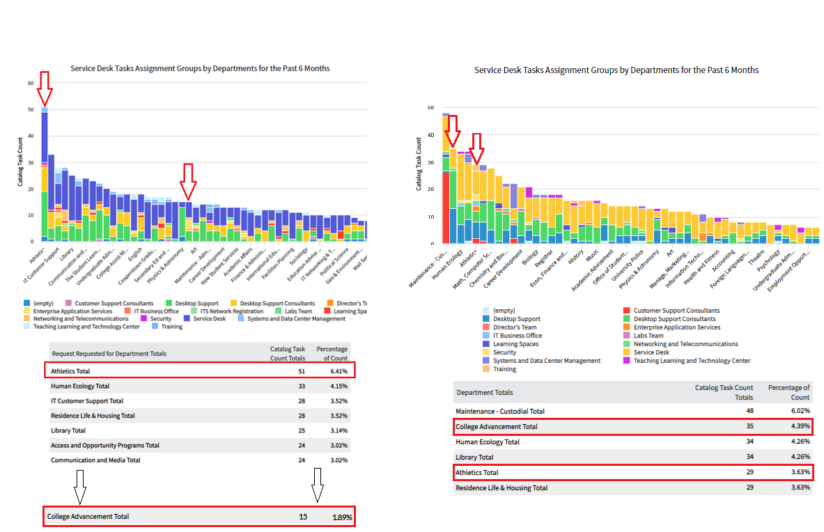
2018 Tasks:
2019 Tasks:

Slide 11
Incoming Students
How do we inform our student population about ITServices?
How do we warn students about Phishing and Malware?
What vector reaches them the best?

Slide 12
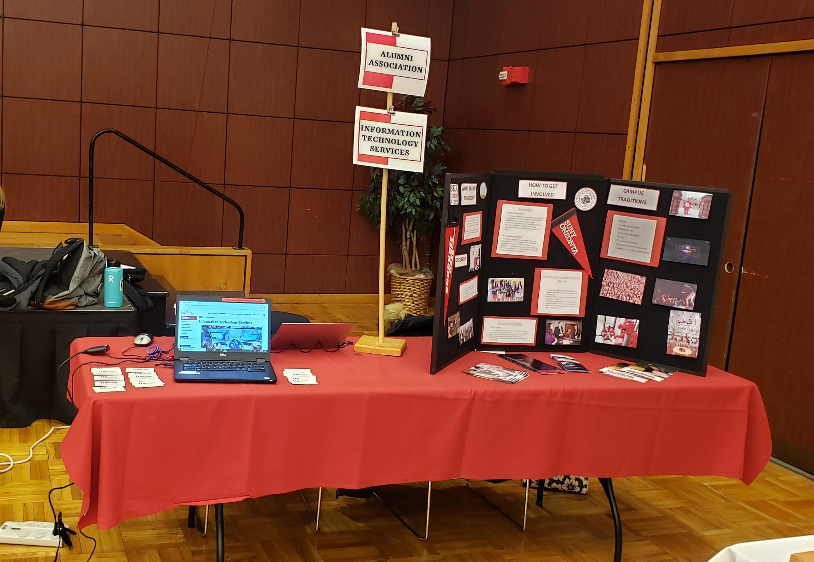

Slide 13
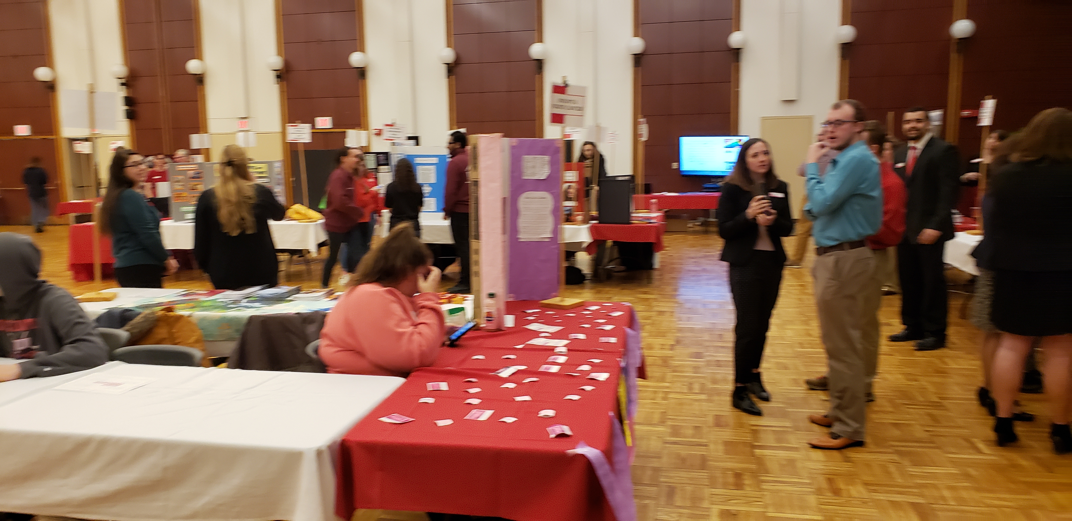

Slide 14
Where do we go from here?

