Slide 1

Follow the Marked Trail to the Top of the Mountain
A Panel Discussion
The State University of New York
vSTC 2020
Wednesday, June 17, 2020
www.suny.edu
Presented by John Lenny

Slide 2



Project Management Professionals Community of Practice
The Project Management Professionals Community of Practice is a discussion group on Workplace that creates a space where:
Project Management Professionals can share their best practices
Discussions are held focusing on project management concepts
People can learn more about project management and topics that affect project management
We hold monthly webinars on the 4th Thursday of the month from 11:00 am to 12:00 pm. We will next meet on 9/24/2020 and 10/22/2020.The webinars focus on topics pertaining to project managers and project management by members of the group. These webinars are only available on Workplace and will be archived to view offline. Past topics include:
Instituting a Project Review Board for Governance with Leadership Support
CAPM and PMP: Two Paths to Project Management Certification
It takes a Village to create the Digital Campus
You can join the PMP CoP at https://bit.ly/2WMFhVX
All are welcome and will be approved after requesting to join.
www.suny.edu

Slide 3
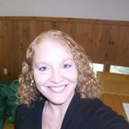
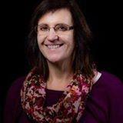
Project Management CoP Moderators
Kris Lynch
  SUNY CPD Program Coordinator
  315-214-2428
  krista.lynch@suny.edu
Christa Glassman
  Director, Project Management Office at ITEC;
  IT Project Manager, SUNY ITEC
  716-878-4832
  christa.glassman@itec.suny.edu
www.suny.edu

Slide 4
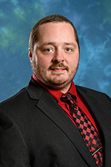
Jonathan Brennan, an IT professional 20+ years of experience, currently serves as the Chief Information Officer (CIO)
at Hudson Valley Community College.
Steeped in higher education technology, he previously served for 6 years as CIO at SUNY Delhi, and 4 more as Director
of IT for The Sage Colleges. He has been very active in several SUNY organizations, having served on the executive boards
of the SUNY Council of Chief Information Officers and Computing Officers Association. He has authored many published
works including the EDUCAUSE Top 10 IT issues article for 2016 and 2017, and was an author and panelist for the
2019 EDUCAUSE/NMC Horizon Report.
Brennan earned a Bachelor of Science in networks and system administration at The Sage Colleges and a Master of
Education in instructional technology from Post University. He holds technical certificates in Project Management (PMP),
Information Security (CISSP), and ITIL Foundations. He also holds certificates in Executive Leadership from Cornell University
and the SUNY Leadership Academy.
www.suny.edu

Slide 5
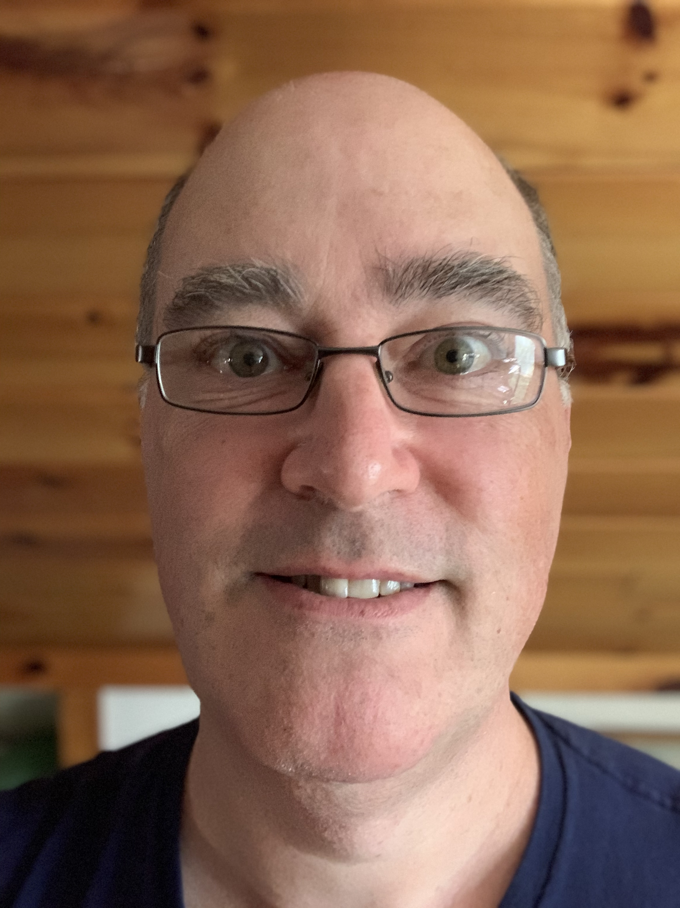
Romeyn Prescott is a northern New York native who worked for SUNY Potsdam for over 23 years and has experience in almost all areas
of I.T. administration and support with focus on Academic Computing issues, including a year and a half as Acting CIO. He very recently
accepted a position with ITEC and has joined their team of Service Delivery Managers. He is secretary of the Rotary Club of Potsdam,
and President of the SUNY Potsdam Alumni Association Board of Trustees.
You can contact Romeyn via email at: Romeyn.Prescott@itec.suny.edu
www.suny.edu

Slide 6
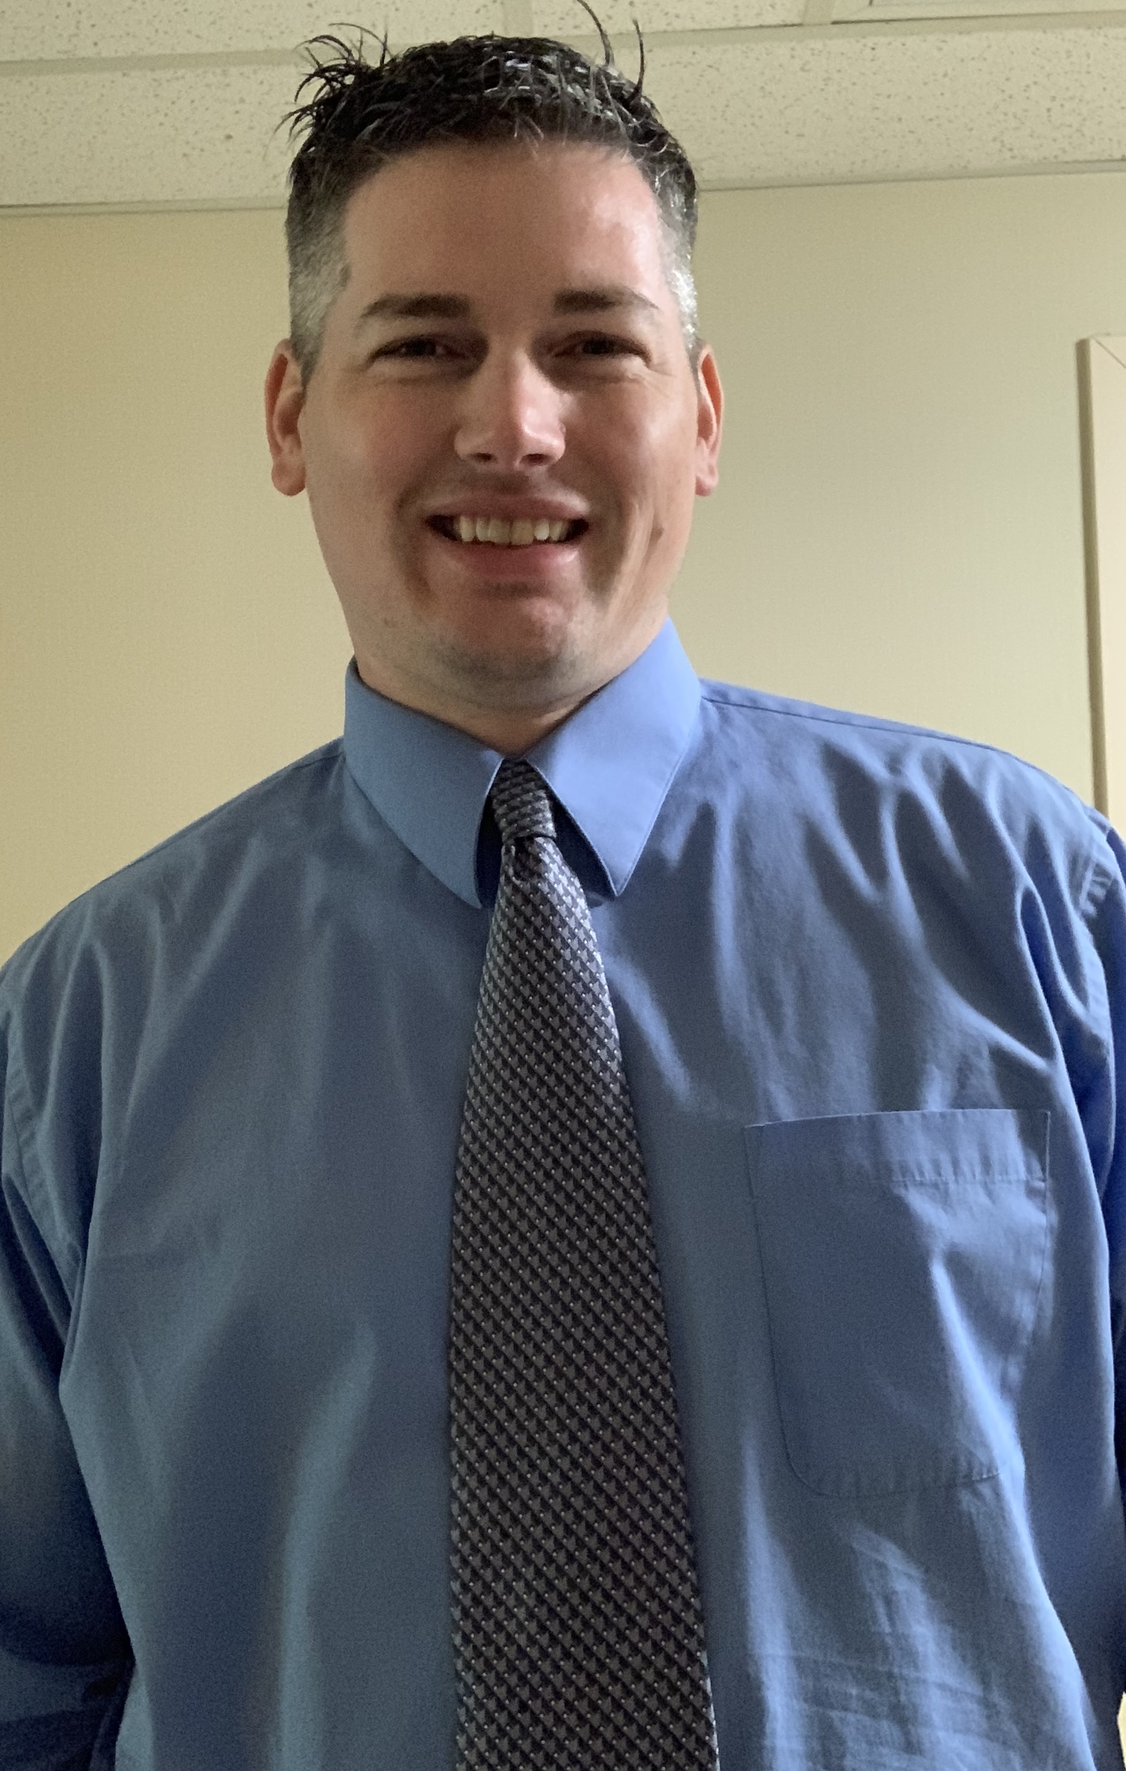
Zachary Jones earned his PMP certification in May of 2019 while he was working at Auburn University as a Project
Manager for IT infrastructure projects. He returned to Binghamton in Sept. 2019 to become the Assistant Director of
Telecommunications. Before working at Auburn, he was a Project & Budget Manager at Binghamton university for
several years. Zachary holds his RCDD from BICSI in IT Infrastructure Design, and is the Director of Communications
for the Binghamton PMI regional chapter. He also holds a master's in Public Administration from Binghamton University.
You can contact Zachary via email at: zjones@binghamton.edu
www.suny.edu

Slide 7
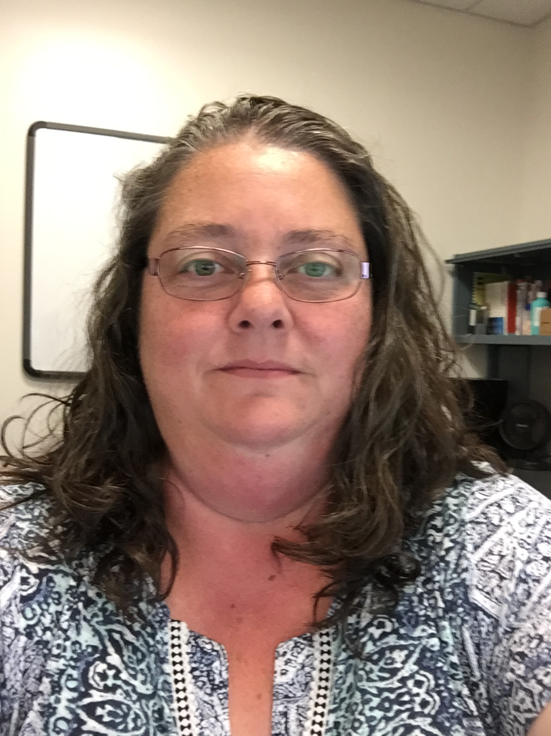
Deb McClenon joined the SUNY community in 1998 serving at both the SUNY Oneonta and University at Albany campuses and
playing many roles. Today Deb leads an exceptional team of System Administrators as the Director of Systems & Data Center Management at
SUNY Oneonta where they are afforded the opportunity to wear many hats - including those of project manager, project team member,
and project sponsor.
You can contact Deb via email at: Deb.McClenon@oneonta.edu
www.suny.edu

Slide 8

Contact Us
Jonathan Brennan
Chief Information Officer
Hudson Valley Community College
(518) 629-7311
j.brennan@hvcc.edu
Kris Lynch
Program Coordinator, SUNY Center for Professional Development
315-214-2428
krista.lynch@suny.edu
Christa Glassman
Director, Project Management Office at ITEC; IT Project Manager, SUNY ITEC
716-878-4832
christa.glassman@itec.suny.edu
www.suny.edu

Slide 9
The State University of New York
www.suny.edu

