Slide 1
SSO, MFA, AAD Oh My
The acronym soup of identity access and authorization

Slide 2
Who we are
Shawn Plummer – Systems Manager
David Warden – Systems Administrator
~5,500 students – ~1,000 Faculty/Staff

Slide 3
Where we were
Apereo CAS 4.2.x
Active Directory (AD) via LDAP for
User authentication
Attribute lookup
Account and password status lookup
SimpleSAML IdP
Apereo CAS for authentication
AD via LDAP for attribute lookup
Homegrown Self-Service Password Reset
Authenticate with PII in Banner to reset password
Not all accounts have Banner records 😢
Enforces AD Fine-Grained Password Policies
Notes:
Dave:
Authenticate with current password to change password
Source data is always a big question. Our CAS has their own HR system and only enter some information into state HR so an account can be created so they are all missing required fields for SSPR

Slide 4
What was good
Open-source systems offered flexibility
Custom patches to Apereo CAS
Custom Banner identity verification for SSPR
Full control over attribute release
Nested group support in SimpleSAML
Attribute name and value manipulation
Decent visibility
Apereo CAS’ “audit log” tracks user activity
Password Reset App logged user activity
SSPR did not require user registration
Notes:
Dave:
Source data is always a big question. Our CAS has their own HR system and only enter some information into state HR so an account can be created so they are all missing required fields for SSPR
These logging systems didn’t implement tracing concepts like hierarchical spans or request ids, making it difficult to see the entire activity stream for a user or a client IP.
CAS logging is frustratingly noisy on debug level yet still doesn’t tell you why a session is killed.

Slide 5
Why we changed
Provide Multi-Factor Authentication
Reduce on-campus infrastructure dependency
Provide more highly available authentication services
Self Service Password Reset (SSPR)
for all accounts, not just ones with Banner records
self-registration enforced during login
using methods not available in homegrown app
that we do not need to maintain
Notes:
Shawn:
Wanted to eliminate on premises dependency for off-premises services, especially as more services are hosted offsite and one of our most important sites for students who work at all hours is our LMS hosted by Canvas.
^ I think we should point out that this requires transitioning the service (like Canvas) to AAD
Login flow integration: during registration you are prompted and that it prompts you every 6 months to keep that information up to date. (Also shared with MFA methods)
Means we did not have to coordinate with 100+ service providers to get the advantages of Microsoft AAD federated login

Slide 6
What our setup is now
Azure Active Directory (AAD)
AAD Connect:
Password Writeback & Sync
AAD Password Protection
SSPR enabled
MFA enabled (opt-in)
Apereo CAS (6.1.x)
SimpleSAML (1.18.x)
Notes:
Dave

Slide 7
Azure Active Directory (AAD)
A web-based identity platform that natively supports a number of federation protocols, authentication methods, and access controls.
Notes:
Dave

Slide 8
AAD Connect Keeps AD and AAD Synchronized
Users and groups
Custom Attribute (extended schema) Sync*
Passwords
AD password changes to AAD via Password Hash Synchronization
AAD password changes to AD via Password Writeback
Every ~30 minutes (passwords “real time”)
Notes:
Dave
Password synchronization was the only way to support our stated goal of removing on premises dependencies

Slide 9
AAD Password Protection Blocks Weak Passwords
Custom blocked word lists
Automatic letter substitution (g3n3s30) 🙅🏻‍♂️
Microsoft “secret” list
Eliminates weak passwords in Cloud – https://docs.microsoft.com/en-us/azure/active-directory/authentication/concept-password-ban-bad
Azure Password Protection Proxy extends this to on premises AD – https://docs.microsoft.com/en-us/azure/active-directory/authentication/concept-password-ban-bad-on-premises
Notes:
Shawn
Requires a proxy agent installed “somewhere” and a separate password filter agent on your DCs.
HA via multiple proxy agents is encouraged, but the DC agents use their last seen policy in the event they cannot reach the proxy agent, and this felt sufficient.

Slide 10
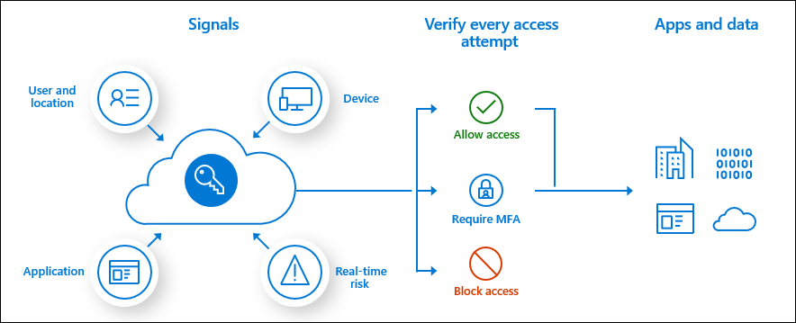
AAD - MFA, Conditional Access
Notes:
Shawn

Slide 11
AAD - Conditional Access Options
Include or exclude specific users, groups, AAD roles
Apply to specific AAD-federated applications
Deny access or require MFA
IP/Geolocation
Require Compliant Device
Risk-based (A5 only)
High risk
Medium Risk
Notes:
Shawn
High Risk - Microsoft works with researchers, law enforcement, various security teams at Microsoft, and other trusted sources to find username and password pairs. When one of these pairs matches an account in your environment, a risk-based password change can be triggered using the following policy.
Medium RIsk - Most users have a normal behavior that can be tracked, when they fall outside of this norm it could be risky to allow them to just sign in. You may want to block that user or maybe just ask them to perform multi-factor authentication to prove that they are really who they say they are. To enable a policy requiring MFA when a risky sign-in is detected, enable the following policy.
MFA Frequency is an option.
Compliance options are things that Intune enrolled devices support such as Requiring a PIN to unlock Requiring device encryption Requiring a minimum or maximum operating system version Requiring a device is not jailbroken or rooted

Slide 12
AAD - MFA Options
Multi Factor Authentication
Microsoft Authenticator app (code and push)
Any TOTP authenticator app
OATH hardware token
SMS
Voice call
Passwordless
Windows Hello for Business
Microsoft Authenticator app
FIDO2 security keys
Notes:
Shawn
OATH tokens must be registered by an admin.

Slide 13
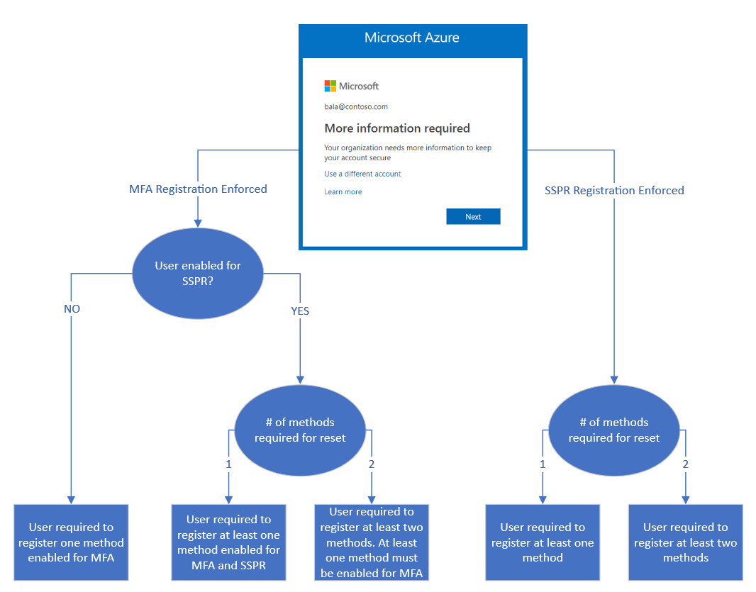
AAD - Combined MFA & SSPR Registration
Preview feature to combine Self-Service Password Reset (SSPR) and MFA method registration
Users can be asked to confirm existing SSPR methods every X days
Notes:
Shawn
https://docs.microsoft.com/en-us/azure/active-directory/authentication/concept-registration-mfa-sspr-combined

Slide 14
CAS Change: Authn Handler
We swapped our CAS LDAP authn handler for Pac4j
Custom AAD OpenID Connect (OIDC) service for CAS
Pac4j authn handler in CAS configured for above OIDC service in AAD
All users forced to use this pac4j authn handler
Allowed “seamless” transition to Azure AD login system
No CAS service changes
No SimpleSAML service or config changes
No URL changes
Notes:
Dave:
This the key way that we did not have to coordinate with 100+ service providers to get the advantages of Microsoft AAD federated login
Dave’s Jan 9 message to SUNYSECPRO-L@ls.sysadm.suny.edu has the details.
Pac4J OIDC: http://www.pac4j.org/docs/clients/openid-connect.html
Shoutout to Leland Hach, Jr. from SUNY Orange who pointed us towards the option to force all logins to be redirected to a pac4j CAS authentication handler.

Slide 15
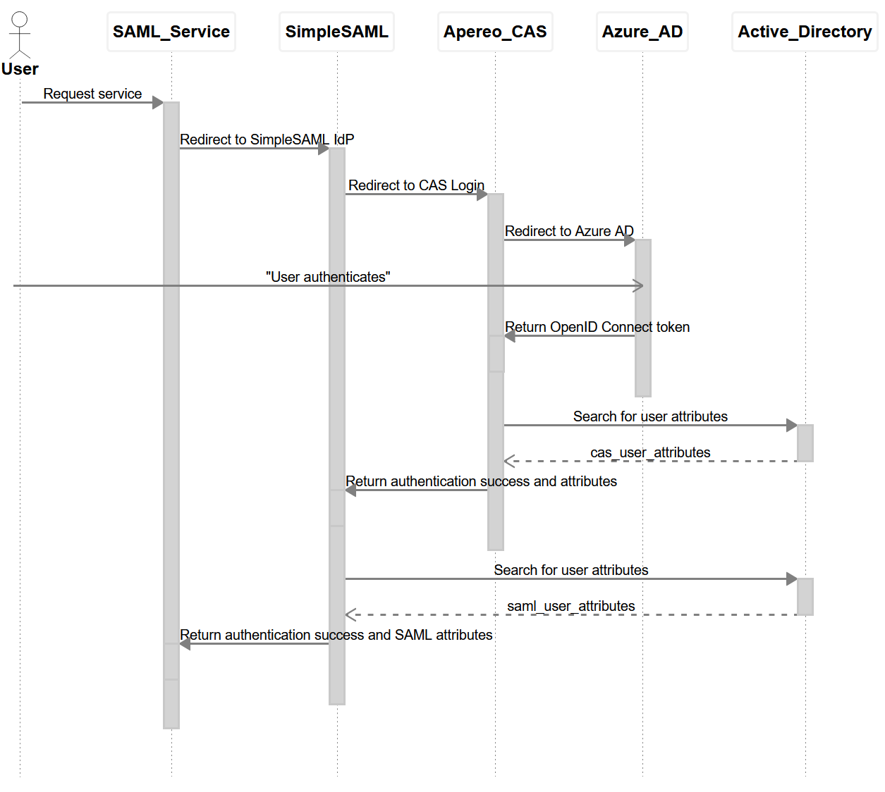
CAS: Authentication Flow
Notes:
Dave:
This is a simplified diagram but it’s worth highlighting that *every web-based system* in this chain has its own session (cookie) management and expiration. Troubleshooting gets complicated fast.
CAS-based services are nearly identical; they simply omit SimpleSAML.
Banner is our biggest CAS service.

Slide 16
Pitfalls/gotchas
Notes:
Dave

Slide 17
Password Hash Sync & Preexpired Passwords
AAD Connect can sync local password changes to AAD
By default, local password changes that indicate a password must be changed do not sync to AAD
Why? 🤷🏻‍♂️
Preview AAD Connect feature to sync preexpired password changes to AAD – https://docs.microsoft.com/en-us/azure/active-directory/hybrid/how-to-connect-password-hash-synchronization#synchronizing-temporary-passwords-and-force-password-change-on-next-logon
Users who authenticate with preexpired password are prompted to pick a new password within AAD
Notes:
Dave

Slide 18
Seamless SSO
AAD Connect feature to silently use Kerberos credentials when authenticating to Azure AD
“Magical” 🔮
Also magically infuriating
Prior to device-based Office licensing, this was how labs signed users in to Office 365 apps
Notes:
Dave:
Reported to us as excessive MFA challenges.
Fix was session persistence option in default Conditional Access Policy.
Additionally:
users struggle to “sign out” logging in as a user other than the OS logged in user is a challenge. Some browsers even pass this auth in incognito/private mode.
Oh god why do I keep getting signed in, why doesn’t it ask me anything?
Docs:
https://docs.microsoft.com/en-us/azure/active-directory/hybrid/how-to-connect-sso-quick-start
https://docs.microsoft.com/en-us/azure/active-directory/hybrid/how-to-connect-sso-how-it-works

Slide 19
CAS Attribute Leaking
CAS was releasing incorrect attributes to some users, who saw attributes from a different user
Traced to:
Near-identical usernames
Where one person authenticated to CAS within 30 minutes of someone with similar username
CAS 6.1.x/Person Directory 1.8.15 defaults to using just usernames as attribute repository cache keys
We disabled attribute caching. Unclear how to use more than just usernames for cache keys
Notes:
Dave
Near-identical usernames:
Same number of characters
Same first and last characters
Examples: abc1 and axy1 are both 4 characters and start and end with the same characters

Slide 20
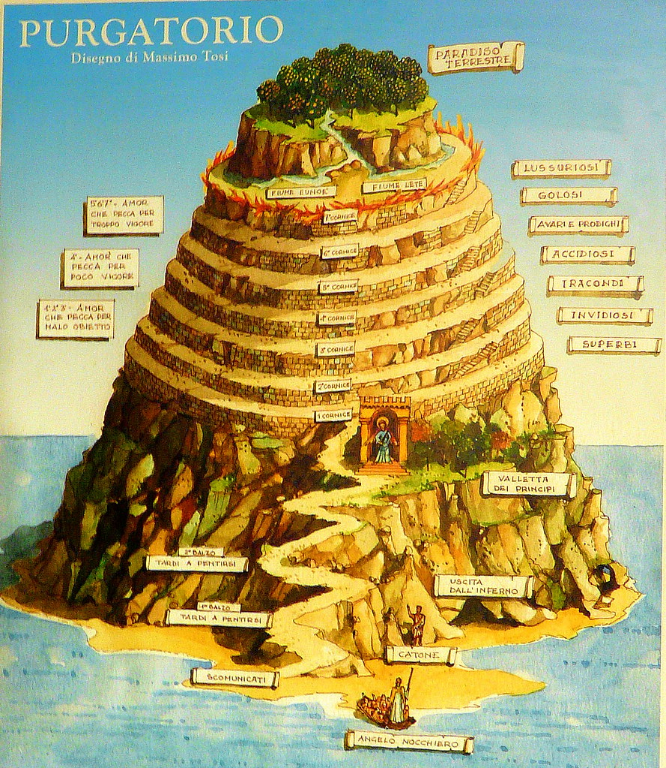
Multiple password reset methods
Requiring more than 1 SSPR method
SSPR/MFA registration purgatory
Users thought we had enabled MFA
Prompted for MFA every login🔥😡
Notes:
We initially rolled out our SSPR requiring users to use 2 methods to reset their password from among
SMS
Phone Call
Security Questions
Authenticator App/Microsoft Authenticator
Alternate e-mail
Of those Security Questions and Alternate e-mail could not be used for MFA
You cannot require people register multiple methods just how many methods are required to reset a password
Many users (~200 at any given time) would register only one methods. This got them in the cycle
BTW accessing your MFA/SSPR methods requires that you use MFA

Slide 21
Pre-load alternate email/mobile
Microsoft has a whole document about how to pre-load SSPR methods – https://docs.microsoft.com/en-us/azure/active-directory/authentication/howto-sspr-authenticationdata
Data loaded via this method is readable by anyone in your domain! https://github.com/MicrosoftDocs/azure-docs/issues/33222
This applies to any synced attributes
Notes:
Shawn
The commands to read the data they list on that page allows any user to read that information. This is bad.
Self registered MFA data is not readable by anyone including global admins.

Slide 22
MFA Wishlist
Based on user or group:
Specify minimum number of registered methods
Control what methods are allowed
Allow offline/recovery one-time codes
Better self-service MFA method management
Notes:
Shawn
Default method selection, renaming methods, distinction between MFA and SSPR methods
“Sign in another way” during MFA challenge does not make sense to people.

Slide 23
Thank You
Shawn Plummer – plummer@geneseo.edu
David Warden – warden@geneseo.edu

