Slide 1
Slate…Banner…Constituo… Oh, My!!!

Slide 2
Today’s Presenters
Scot Beekman
Assistant Director of Administrative Information Systems (ITS)
19 years at SUNY Broome
Have a 7 year old Sith Lord
Randy Harvey
Programmer Analyst II
3 years at SUNY Broome
Senator Palpatine was my apprentice

Slide 3
Our Situation
SUNY Broome Community College
4,500 FTE and 5,000 - 7,000 headcount per academic year
11,000 Admissions applications per year
Admission was using Self Service Banner Applications
Didn’t like it
Found it hard to do targeted communications
Purchased Slate as student CRM

Slide 4
Our Objective
The Evaluation Process
Context (Need Slate application data in Banner):
Develop In-House solution (reviewed Binghamton University’s implementation)
Talk to SICAS about a solution
Evaluated 3 commercial solutions (Axiom, Constituo, & Rapid Insight)
Considerations:
Constrained timeline / budget
Ease of deployment, configuration, day to day use
Required knowledgeable, attentive, responsive services team to lead us to success
Suggested by SICAS / SUNY System Administration

Slide 5
Our Implementation
Slate / Constituo / Banner Integration
Data: Slate application data to be exported (Fields? - Prompts?)

Slide 6
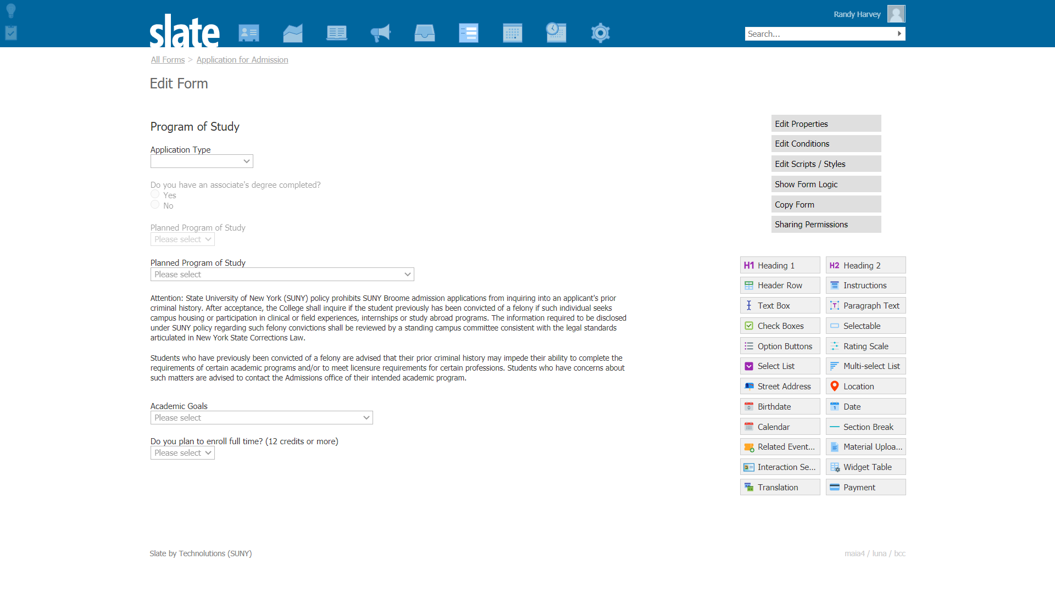
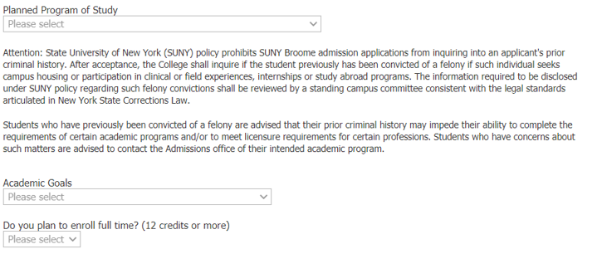

Slide 9
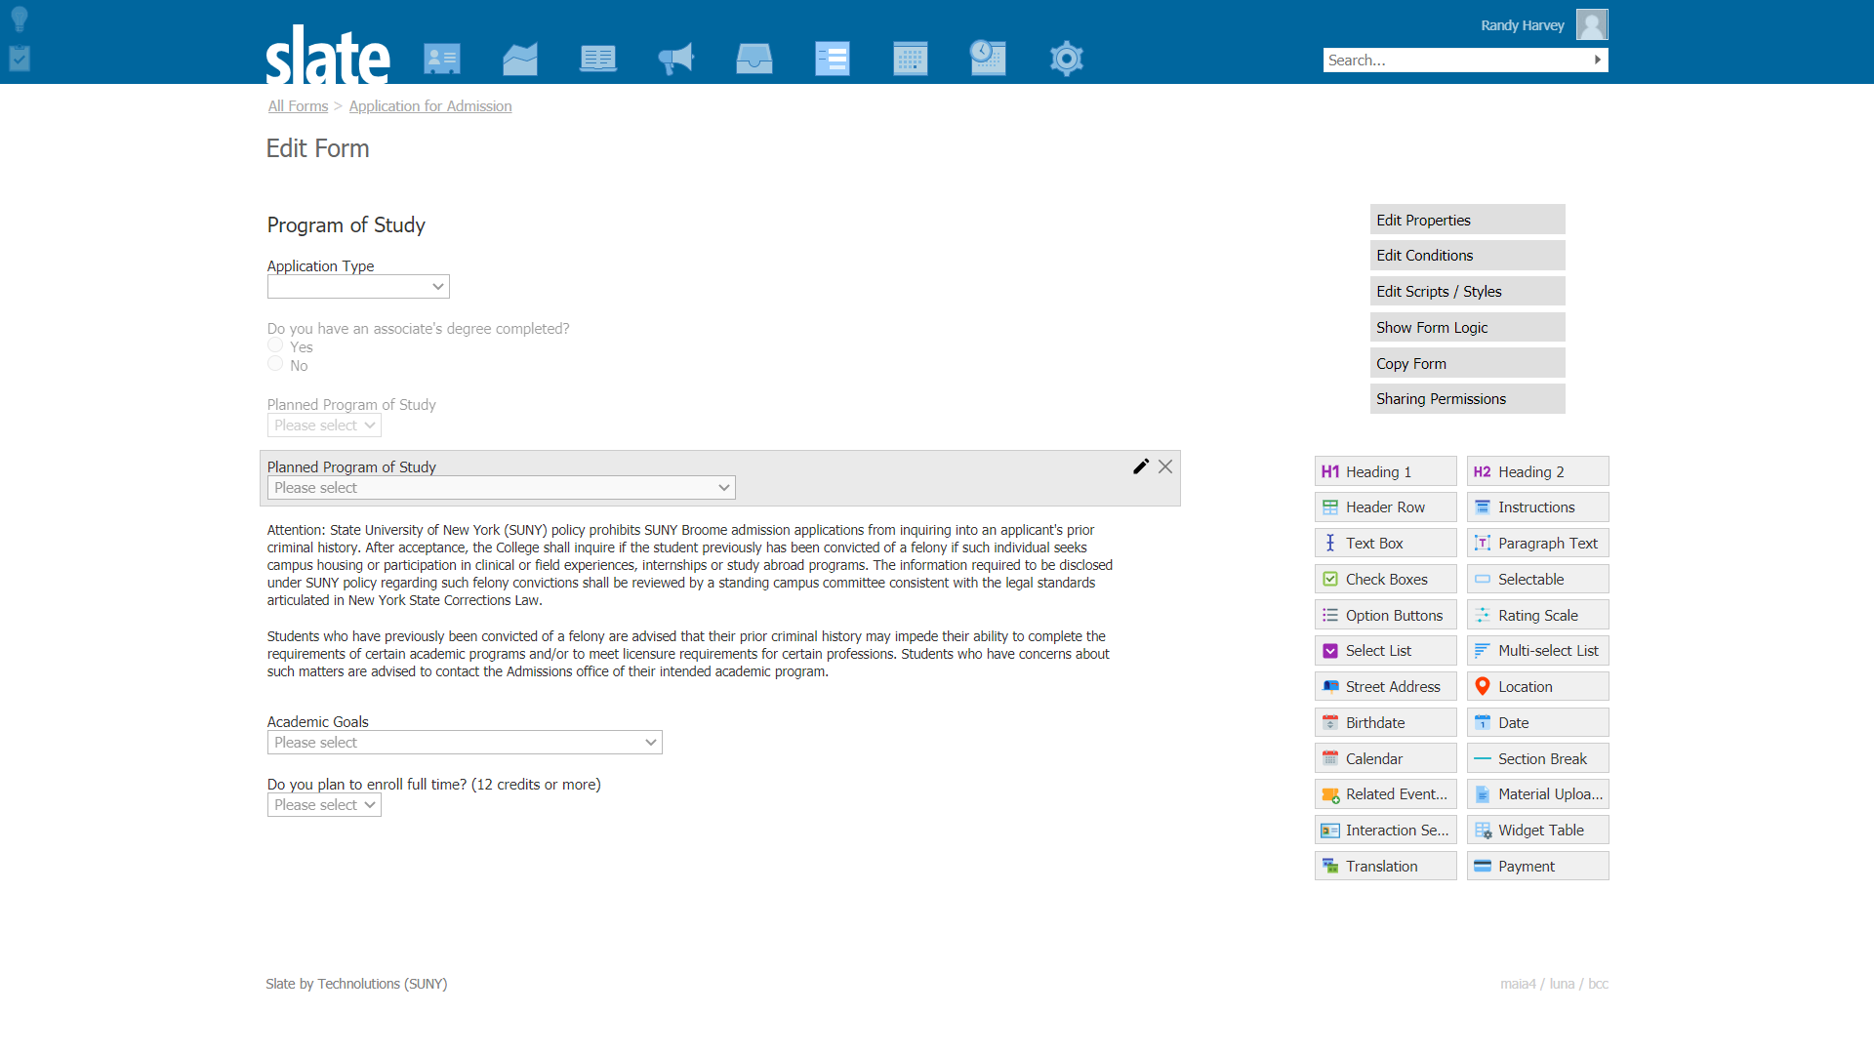
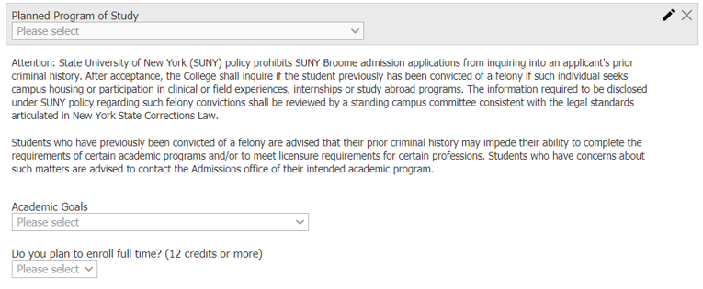

Slide 10
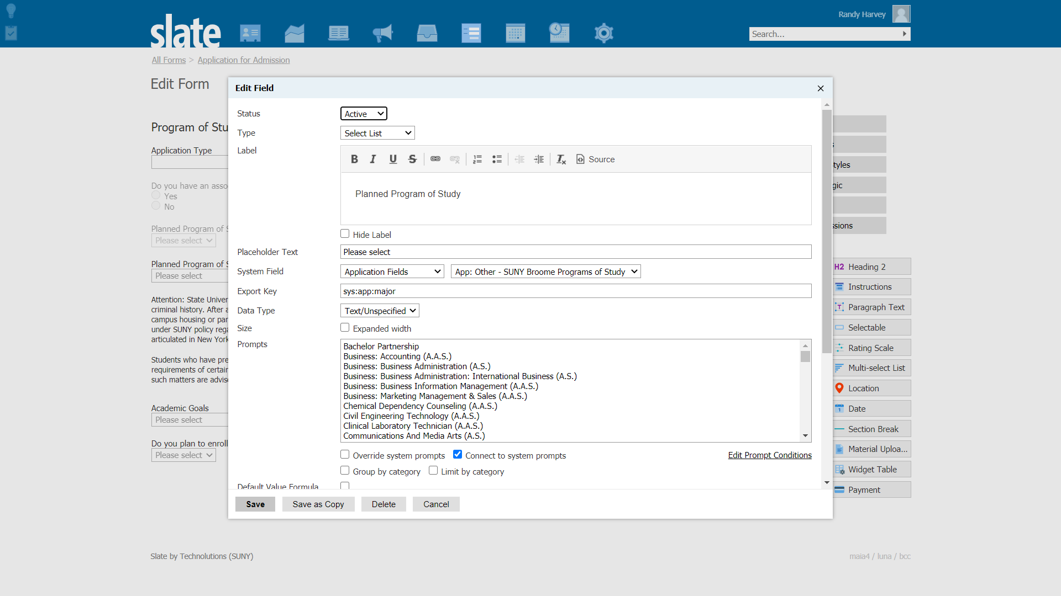

Slide 11
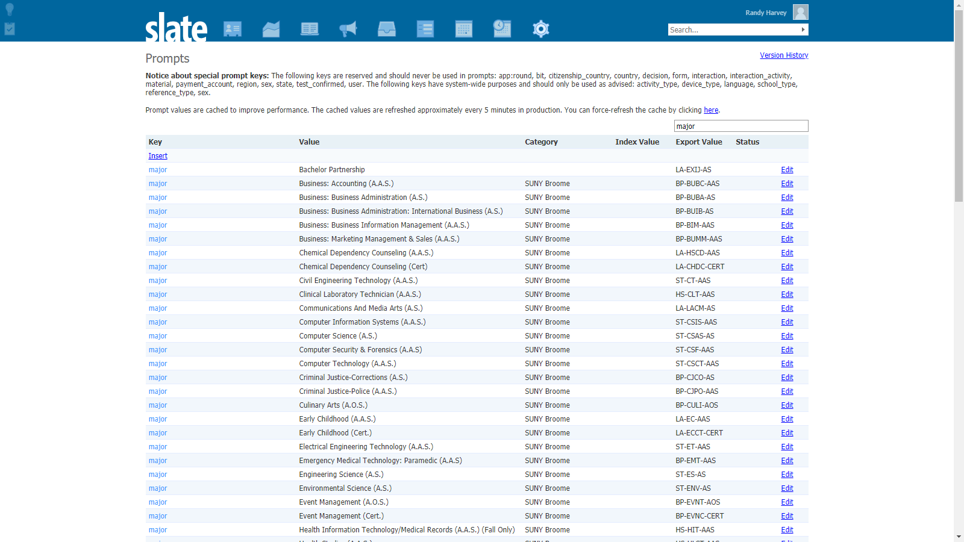

Slide 13
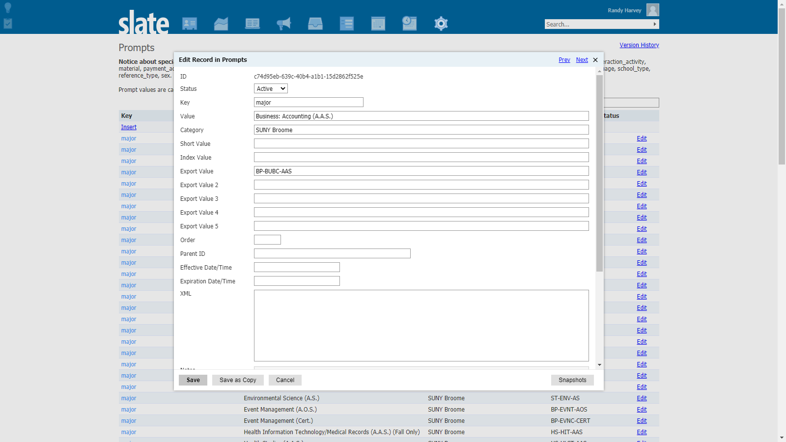

Slide 14
Our Implementation
Slate / Constituo / Banner Integration
Data: Slate application data to be exported (Fields? - Prompts?)
Extract: Slate data via SFTP (API Available)

Slide 15
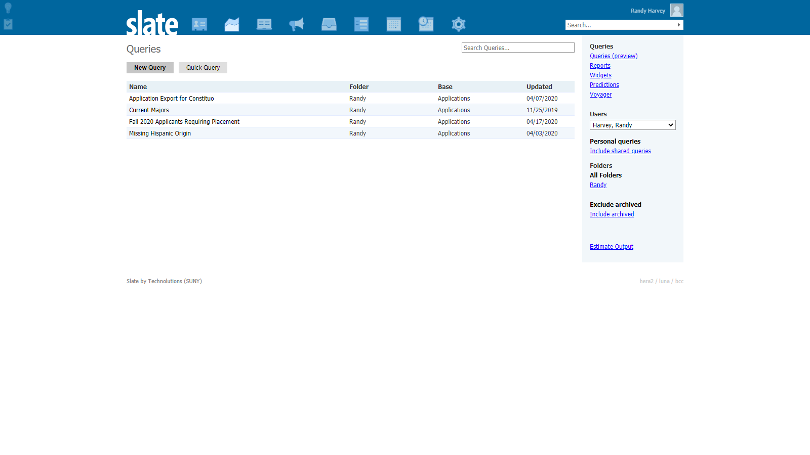

Slide 17
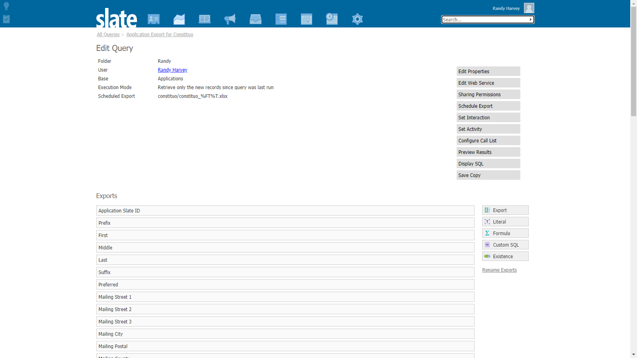

Slide 19
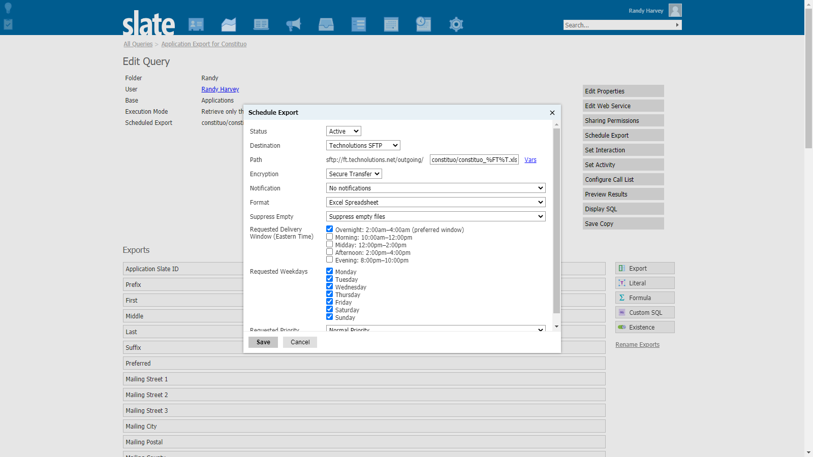

Slide 20
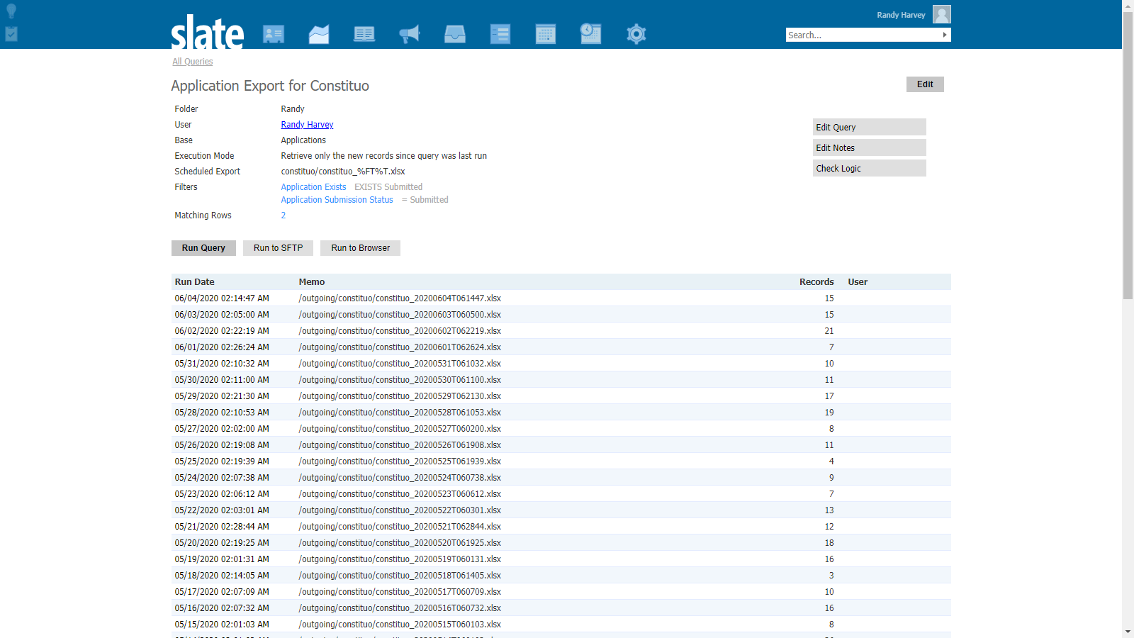

Slide 22
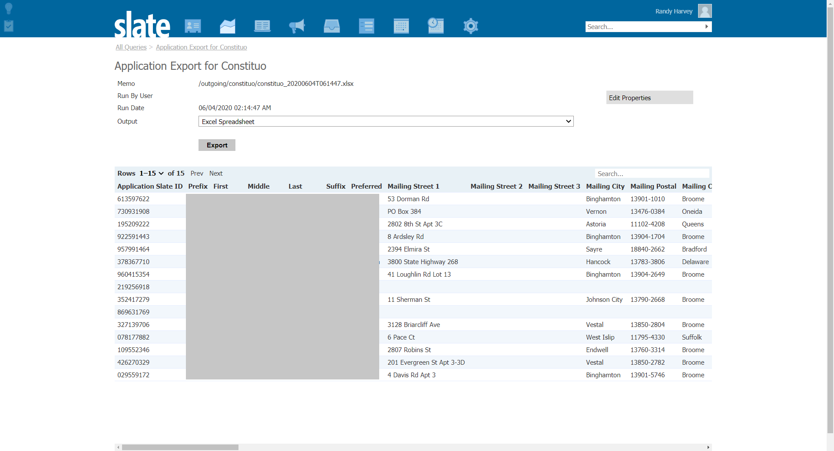

Slide 23
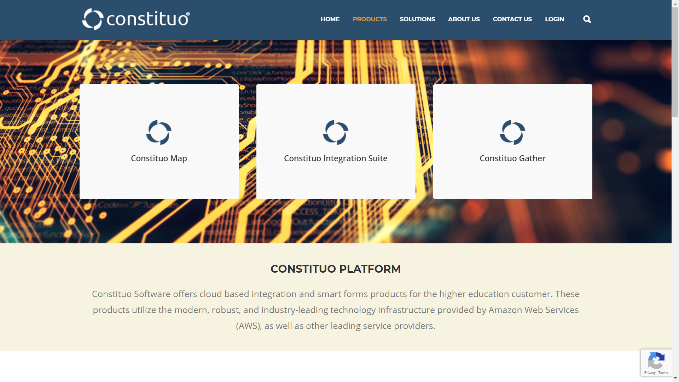

Slide 24
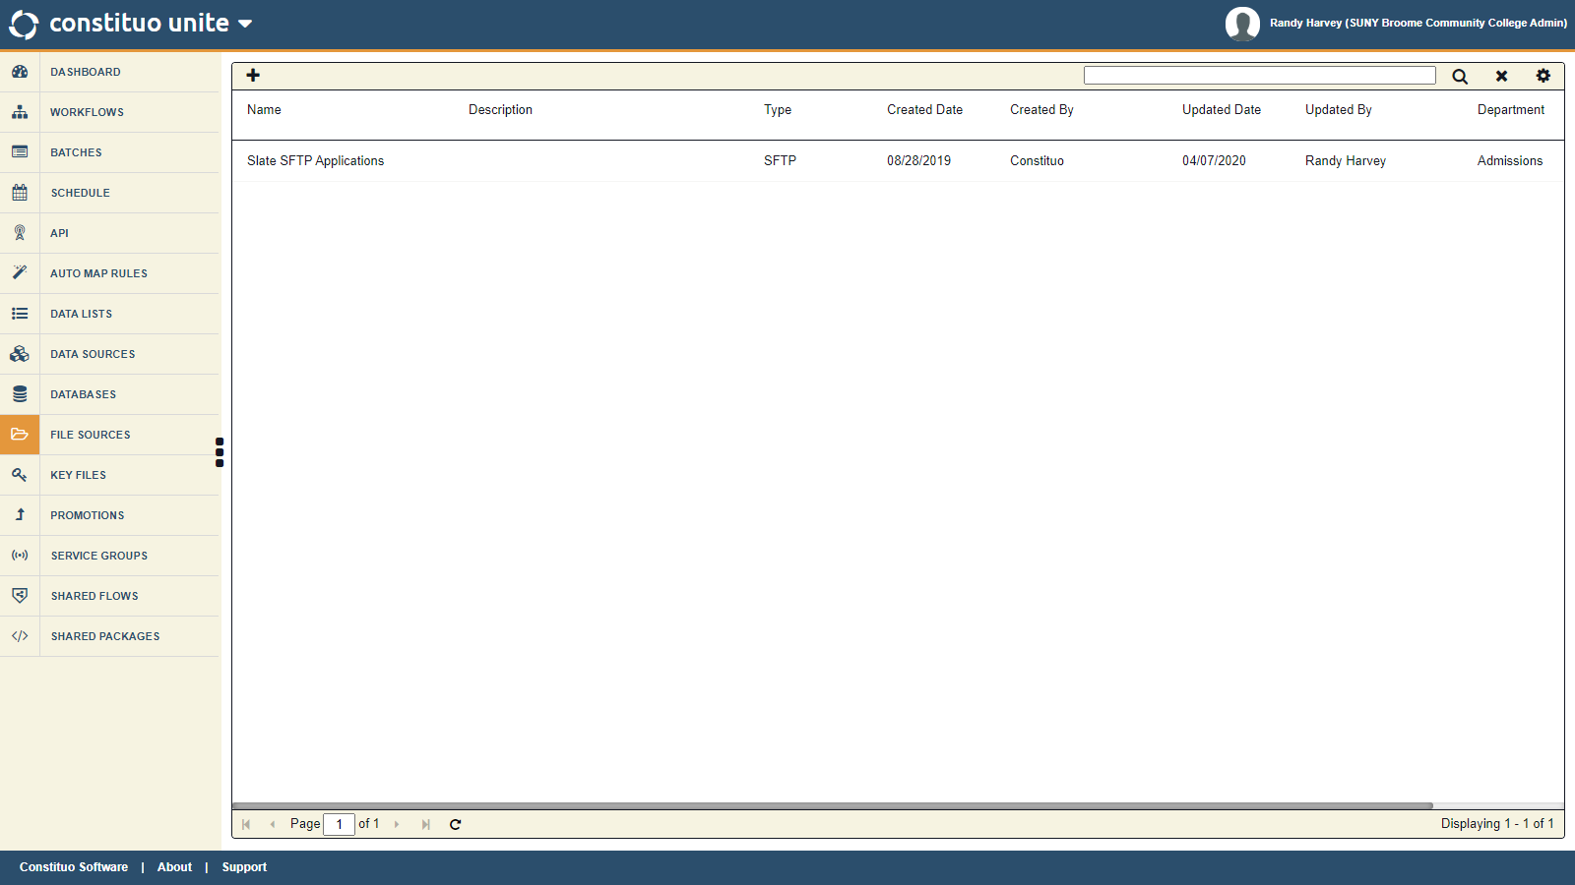

Slide 26
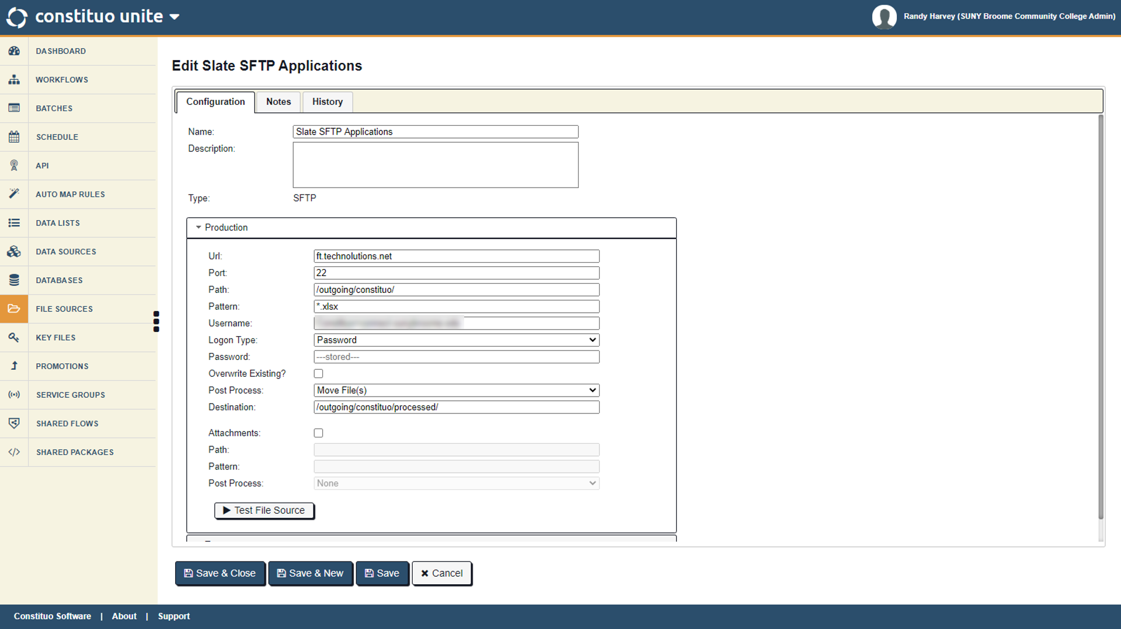

Slide 28
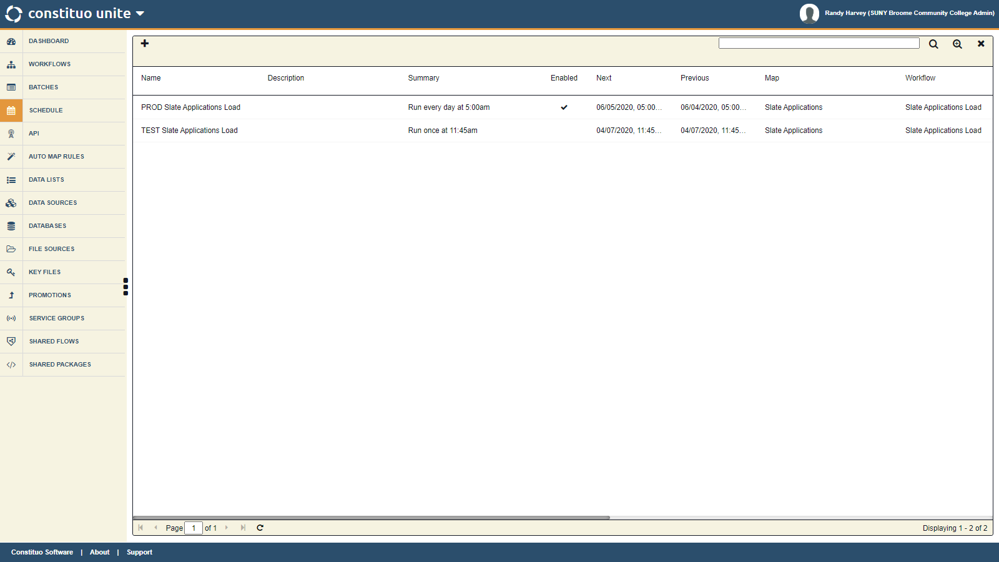

Slide 29
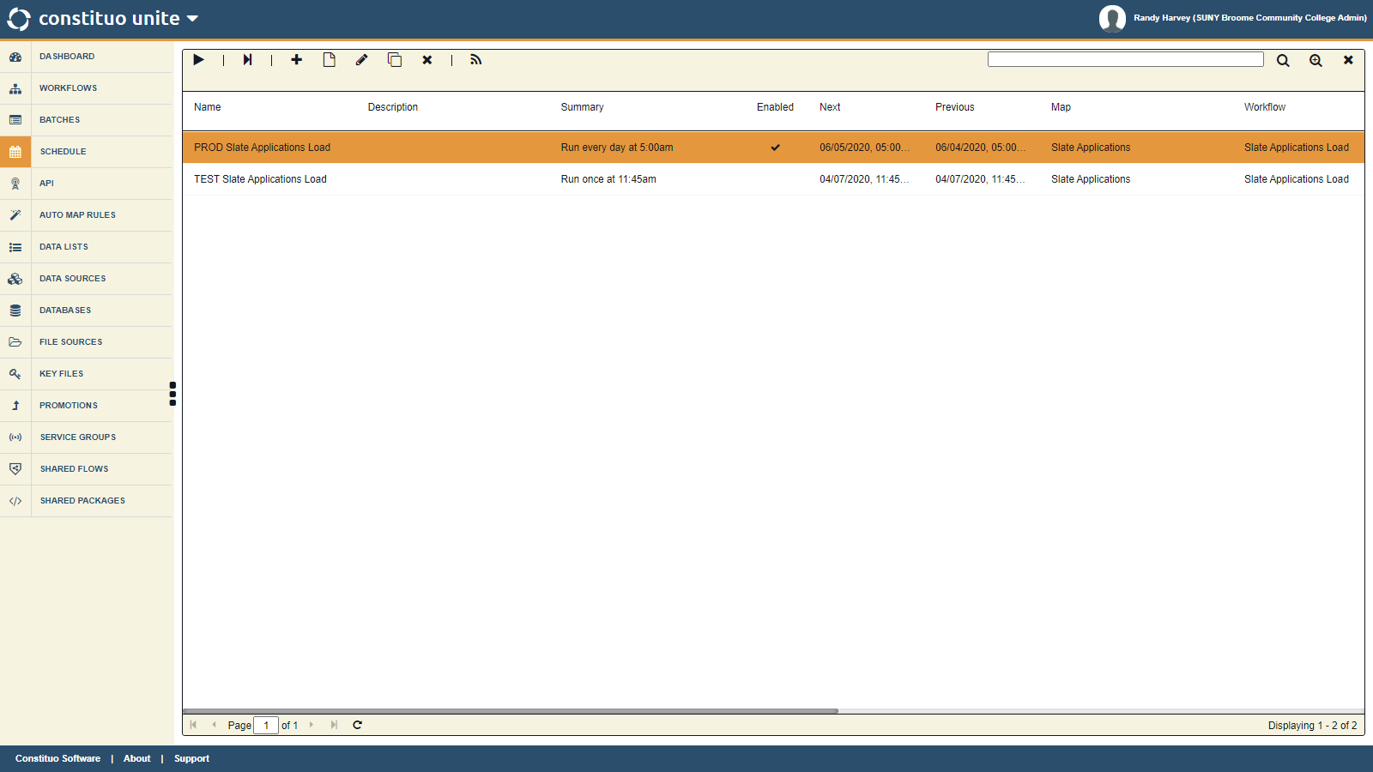

Slide 30
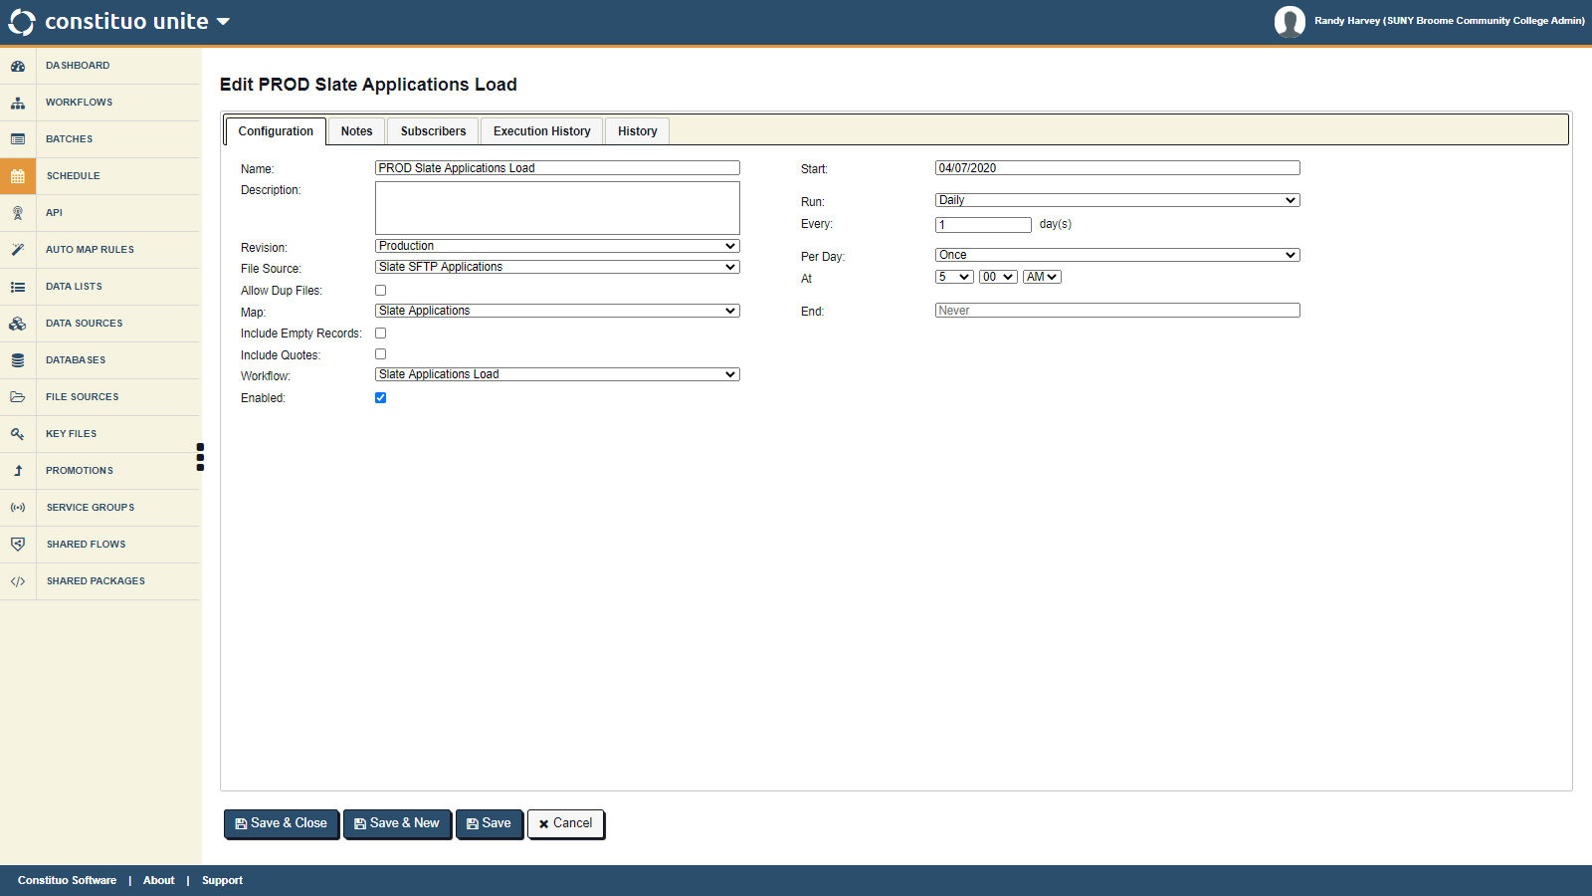

Slide 31
Our Implementation
Slate / Constituo / Banner Integration
Data: Slate application data to be exported (Fields? - Prompts?)
Extract: Slate data via SFTP (API Available)
Transform: Data to prepare for upsert into Banner

Slide 32
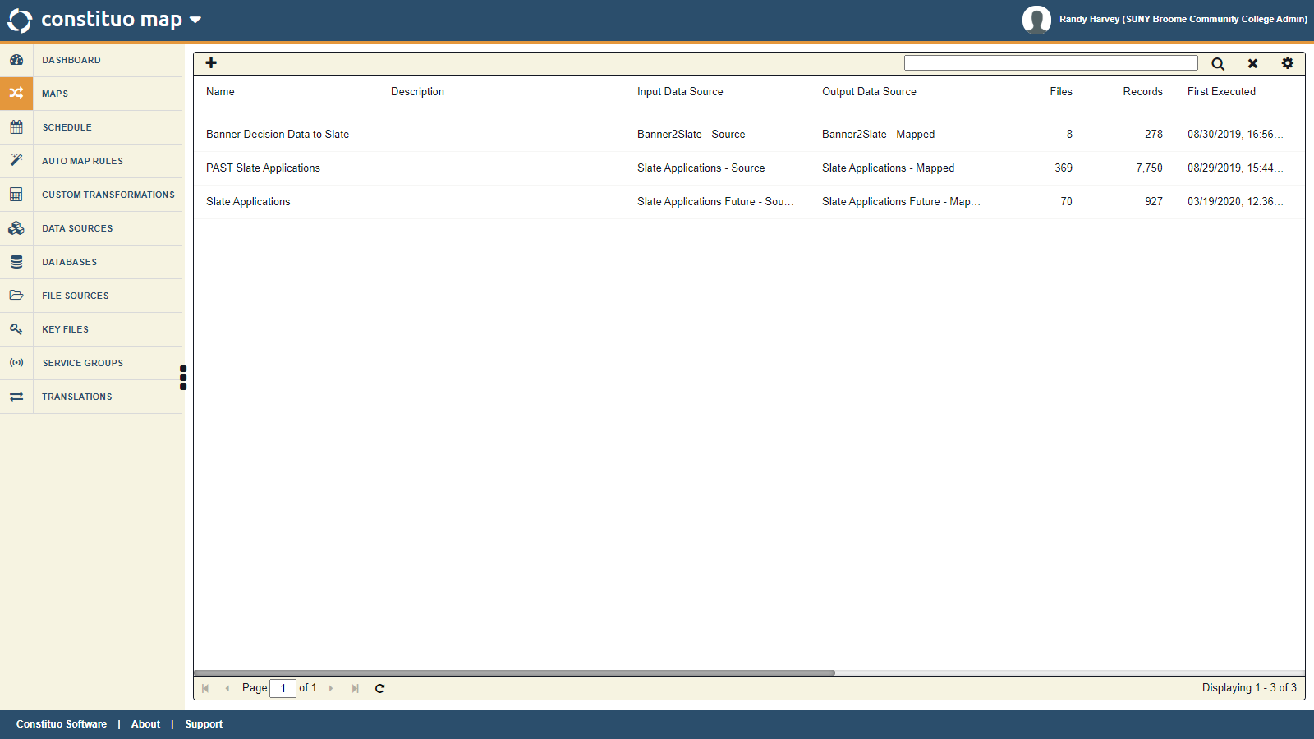

Slide 33
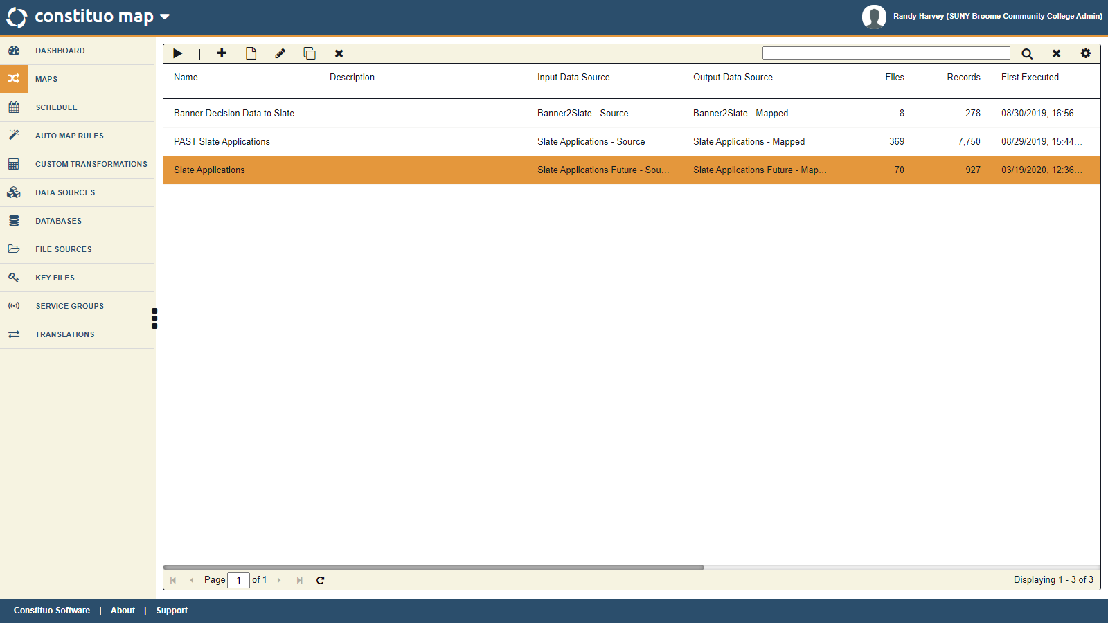

Slide 34
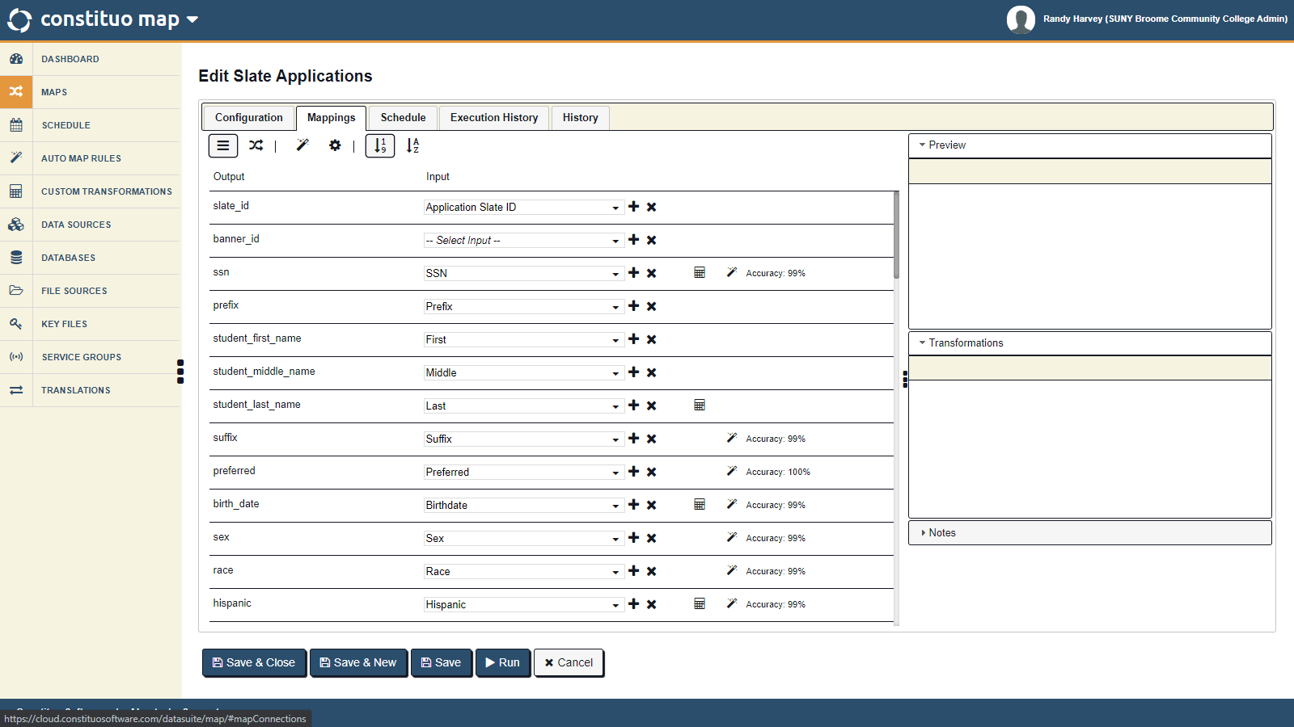

Slide 36
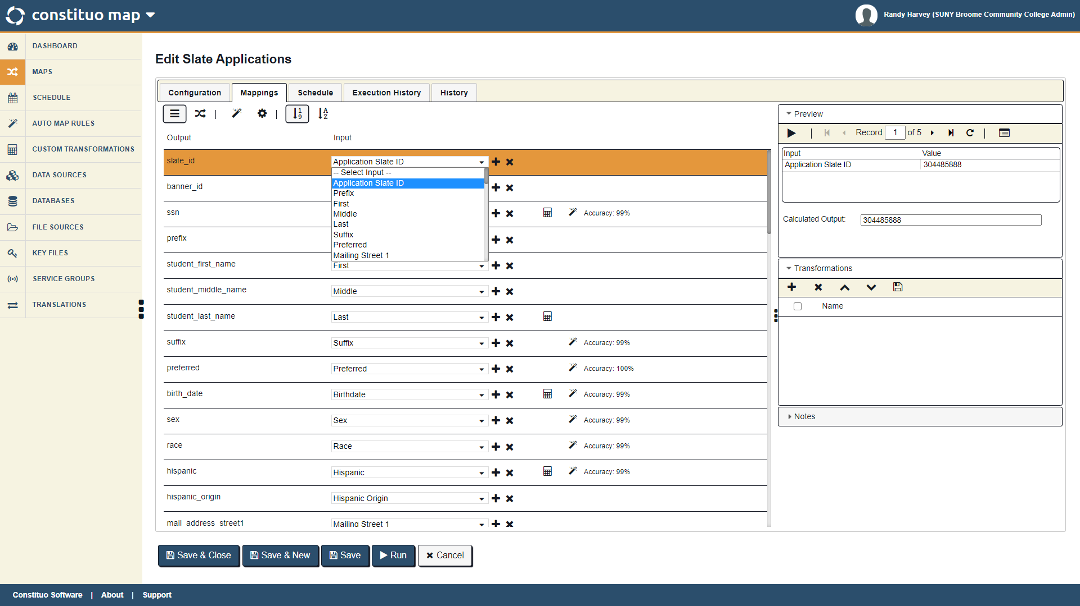

Slide 37
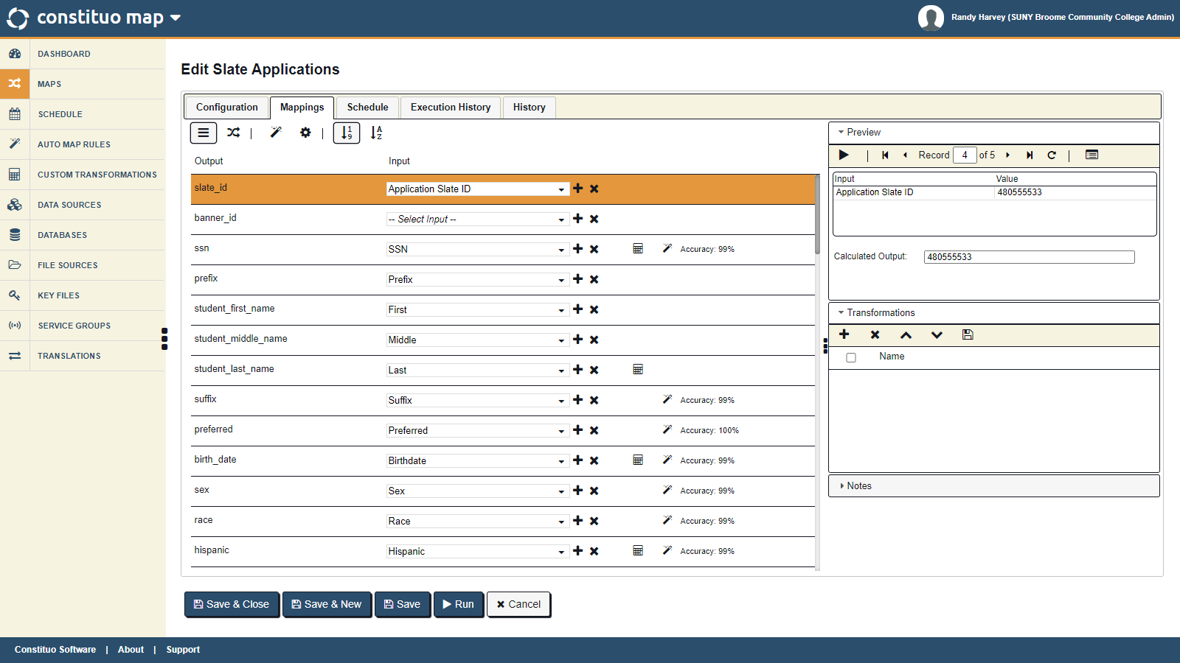

Slide 42
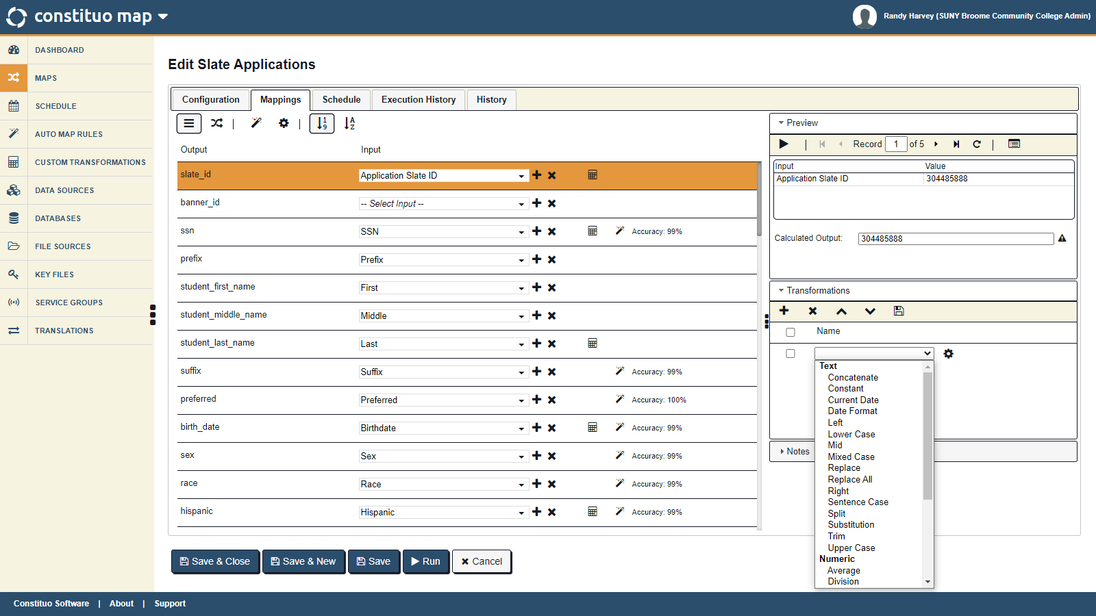

Slide 43
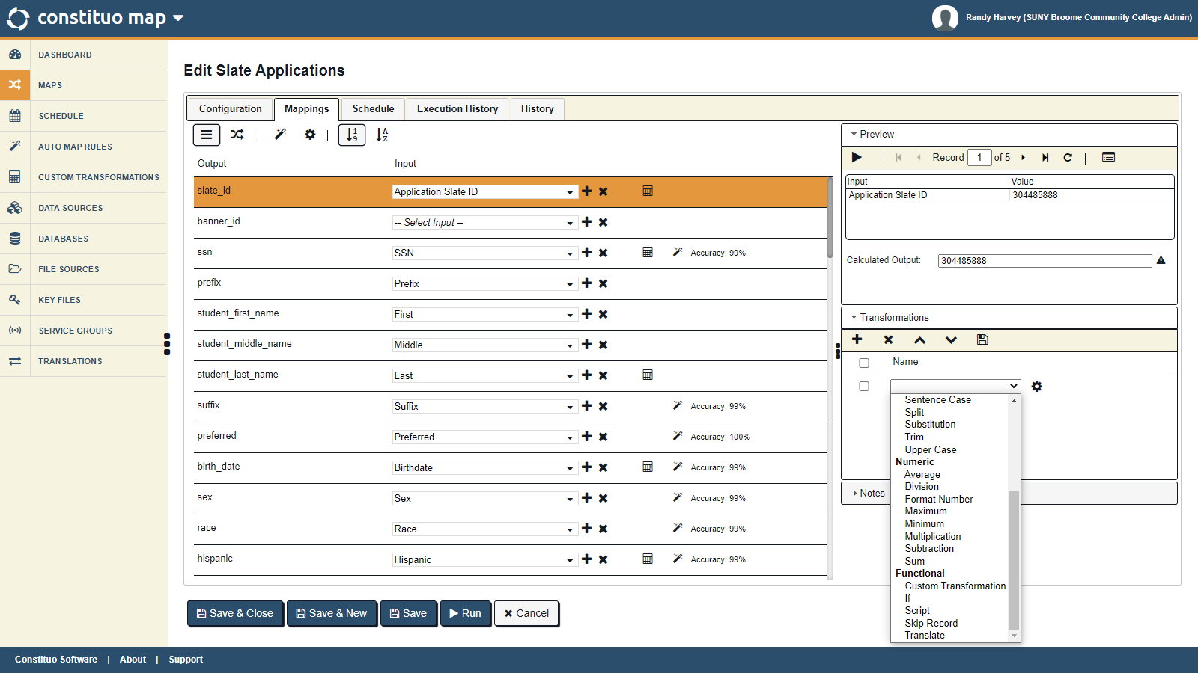

Slide 45
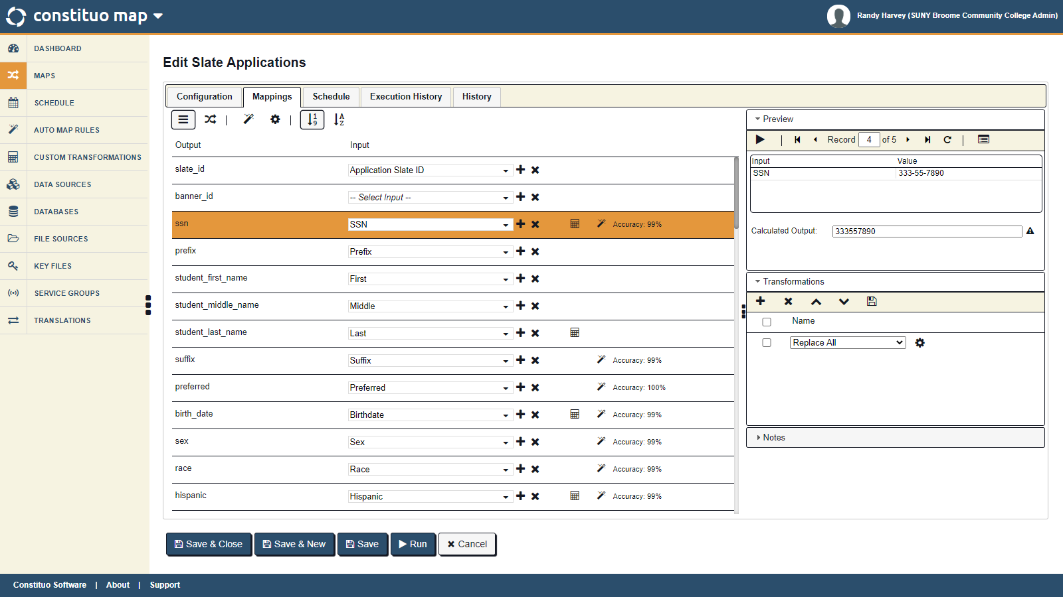

Slide 47
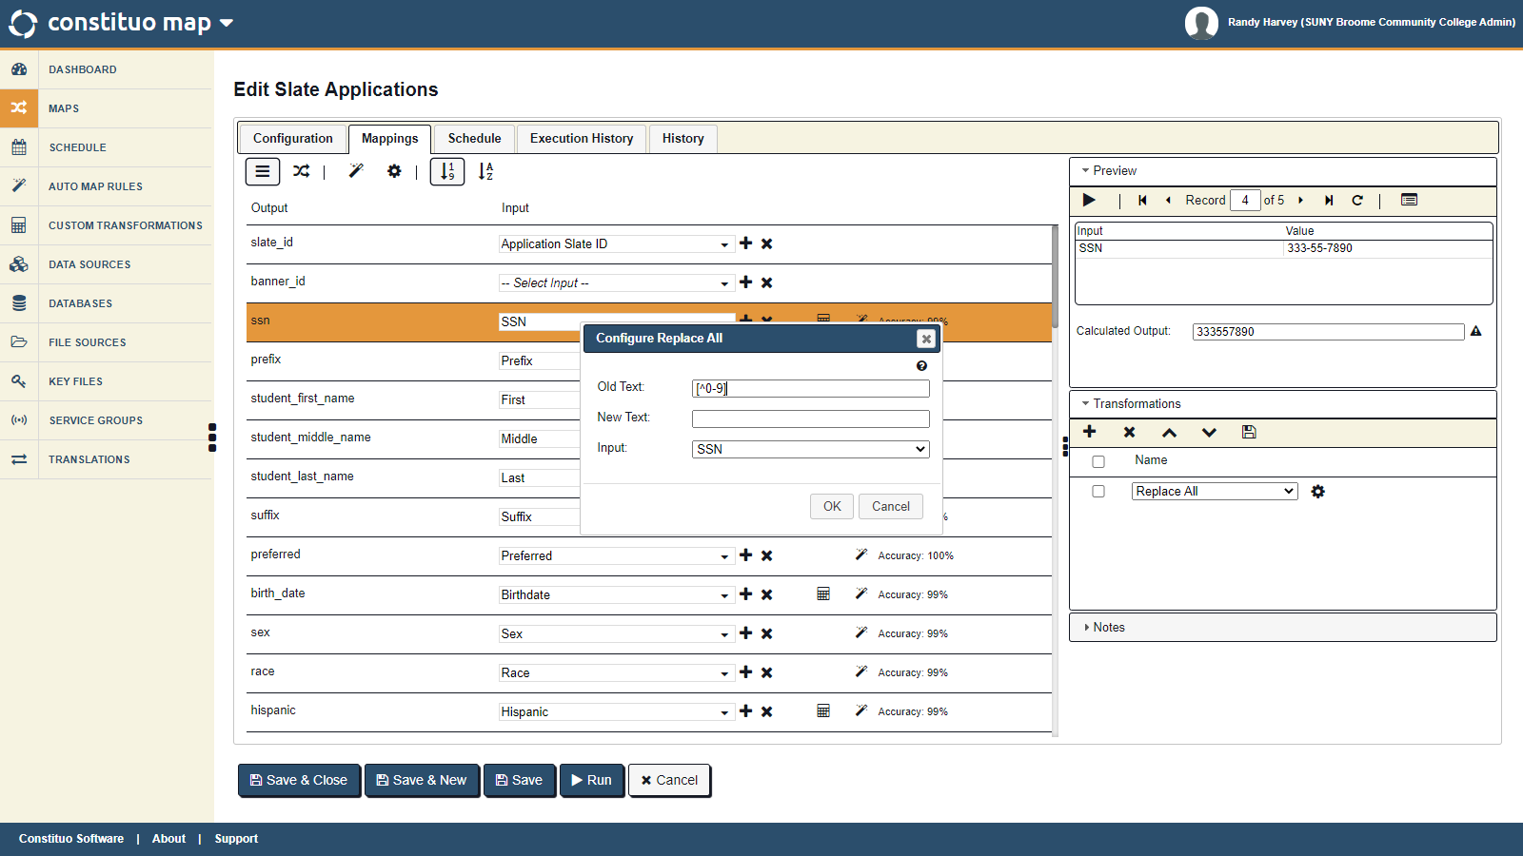

Slide 50
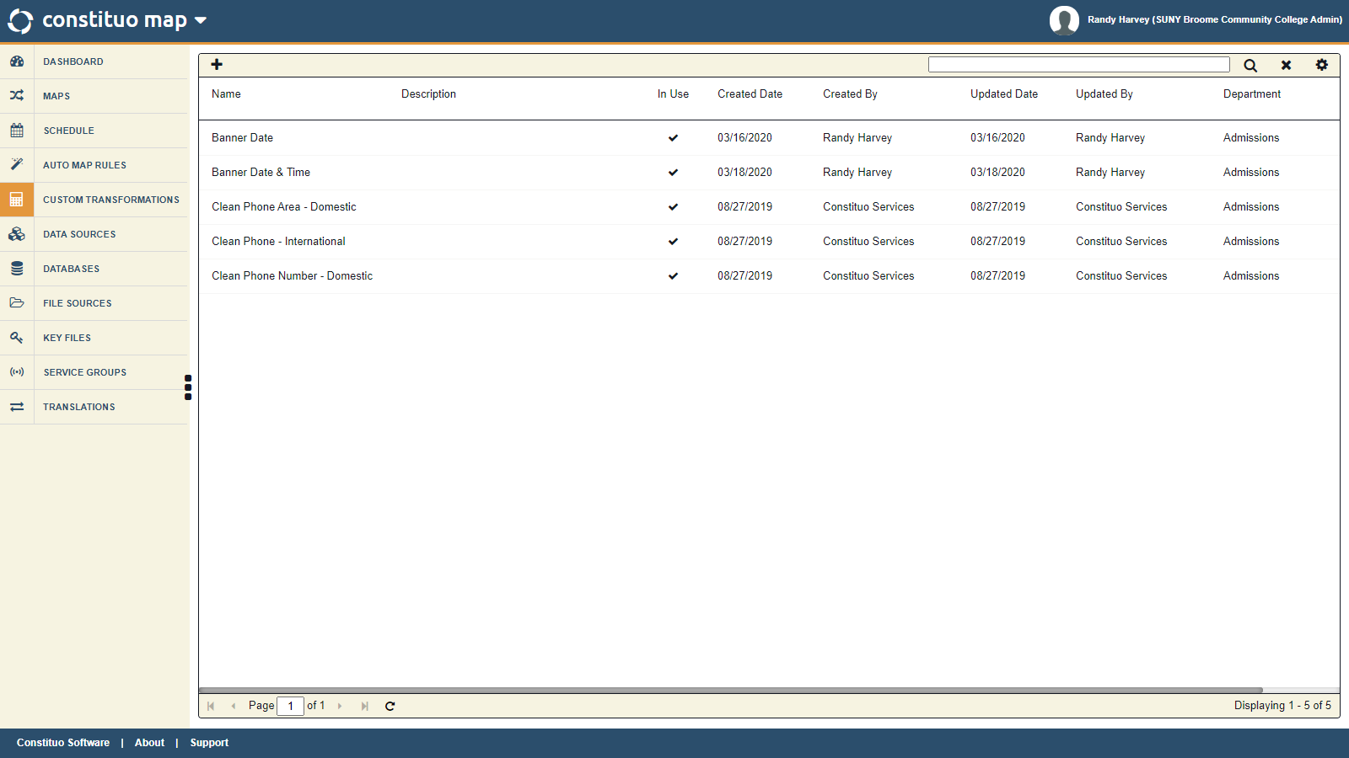

Slide 51
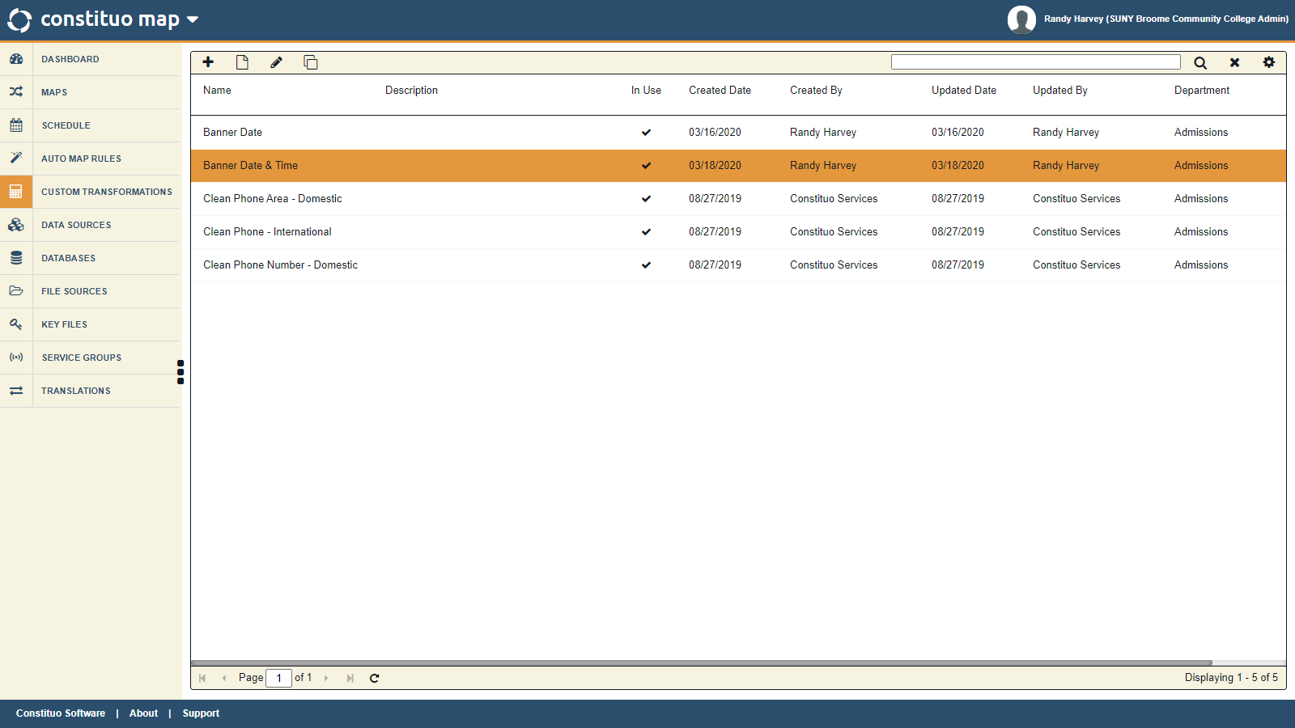

Slide 52
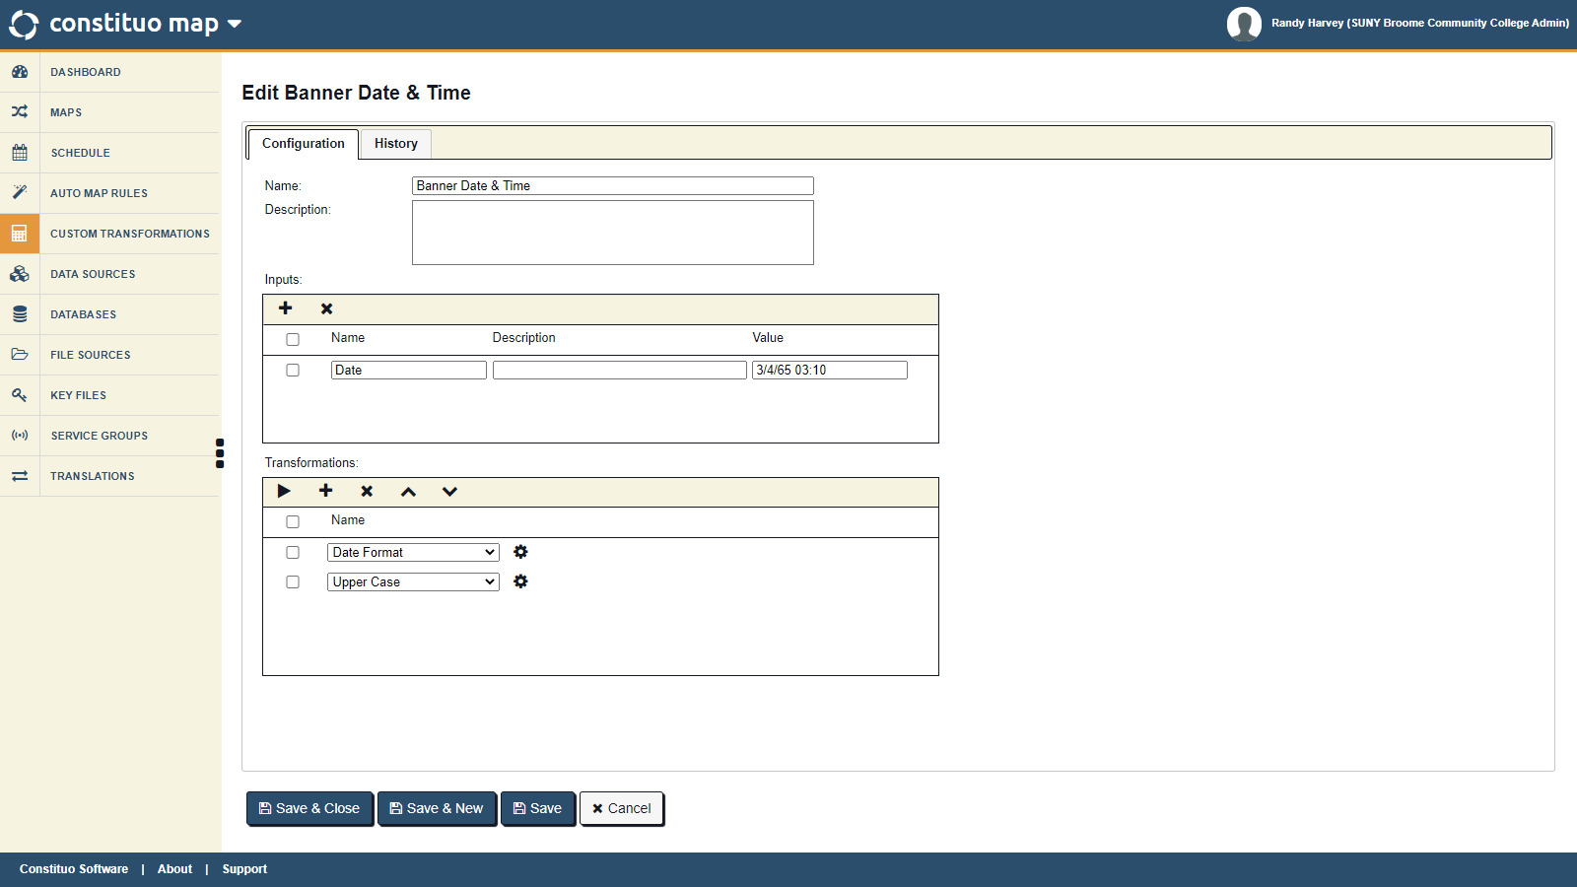

Slide 54
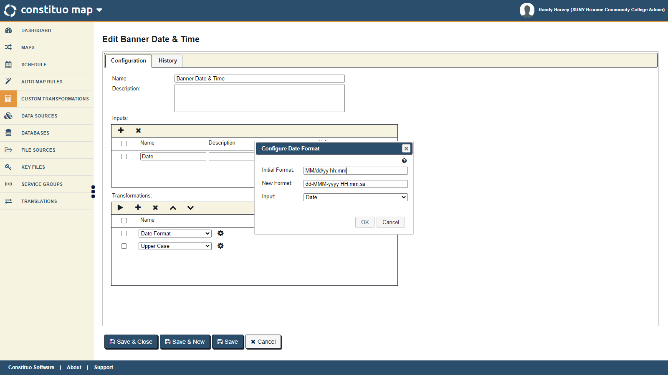

Slide 55
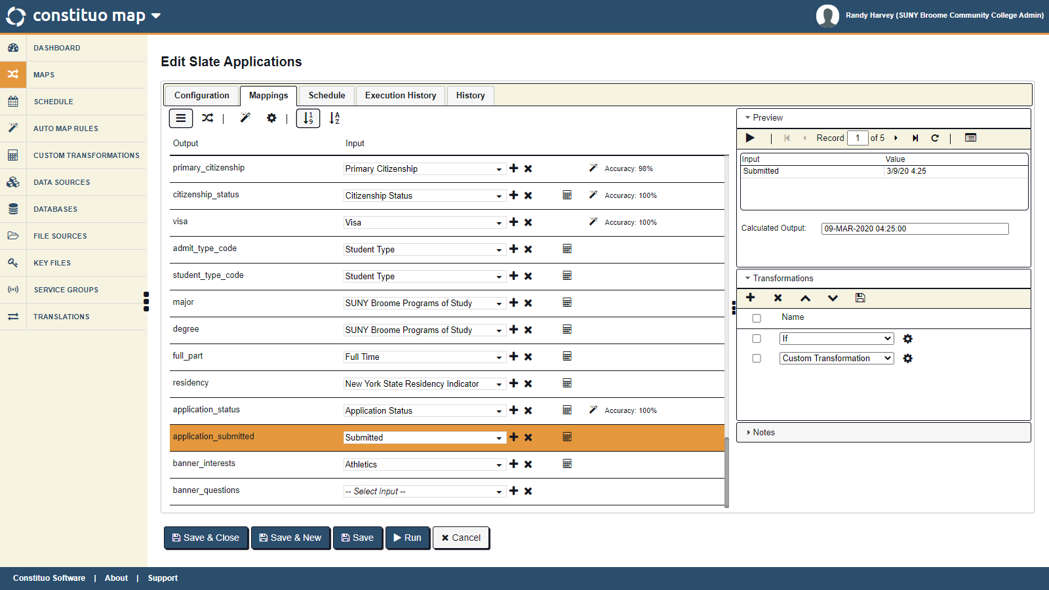

Slide 57
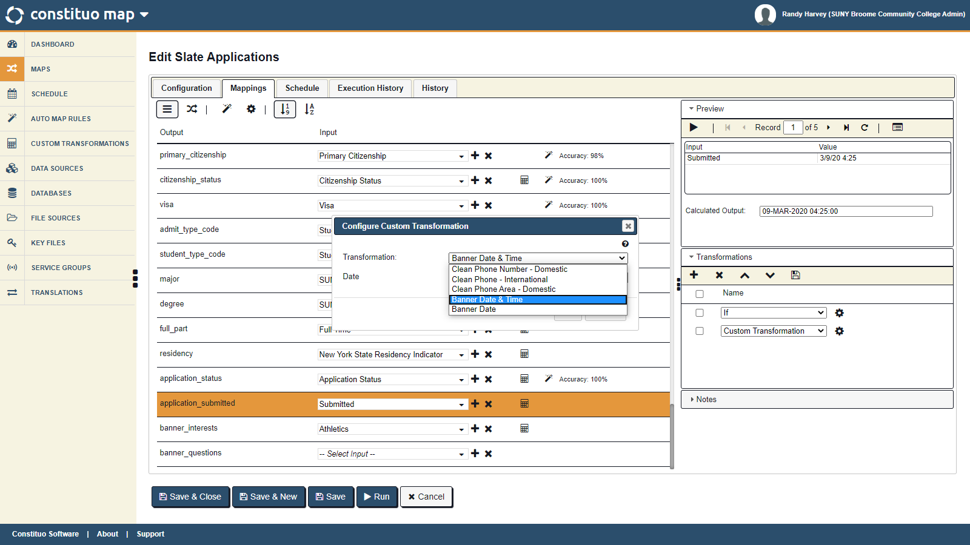

Slide 60
Our Implementation
Slate / Constituo / Banner Integration
Data: Slate application data to be exported (Fields? - Prompts?)
Extract: Slate data via SFTP (API Available)
Transform: Data to prepare for upsert into Banner
Load: Data using robust matching to avoid duplicates

Slide 61
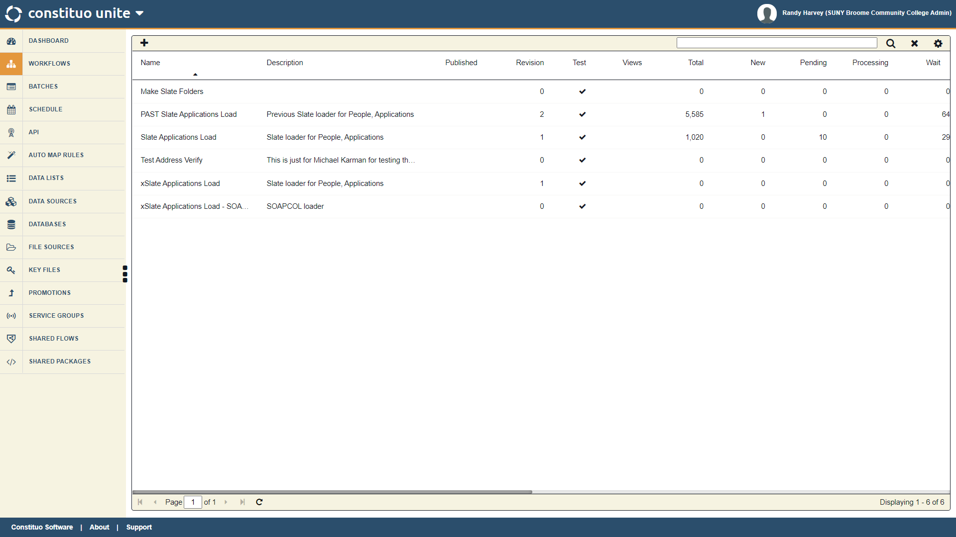

Slide 62
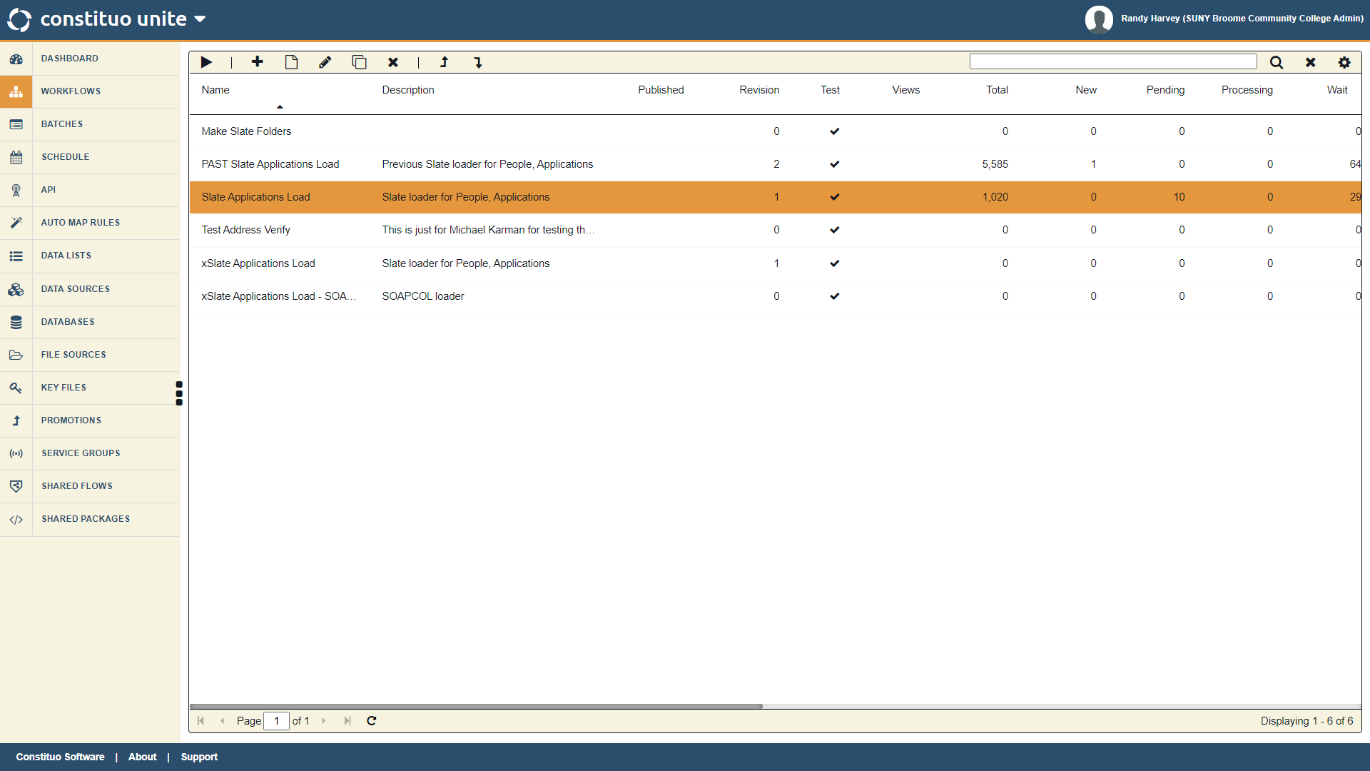

Slide 64
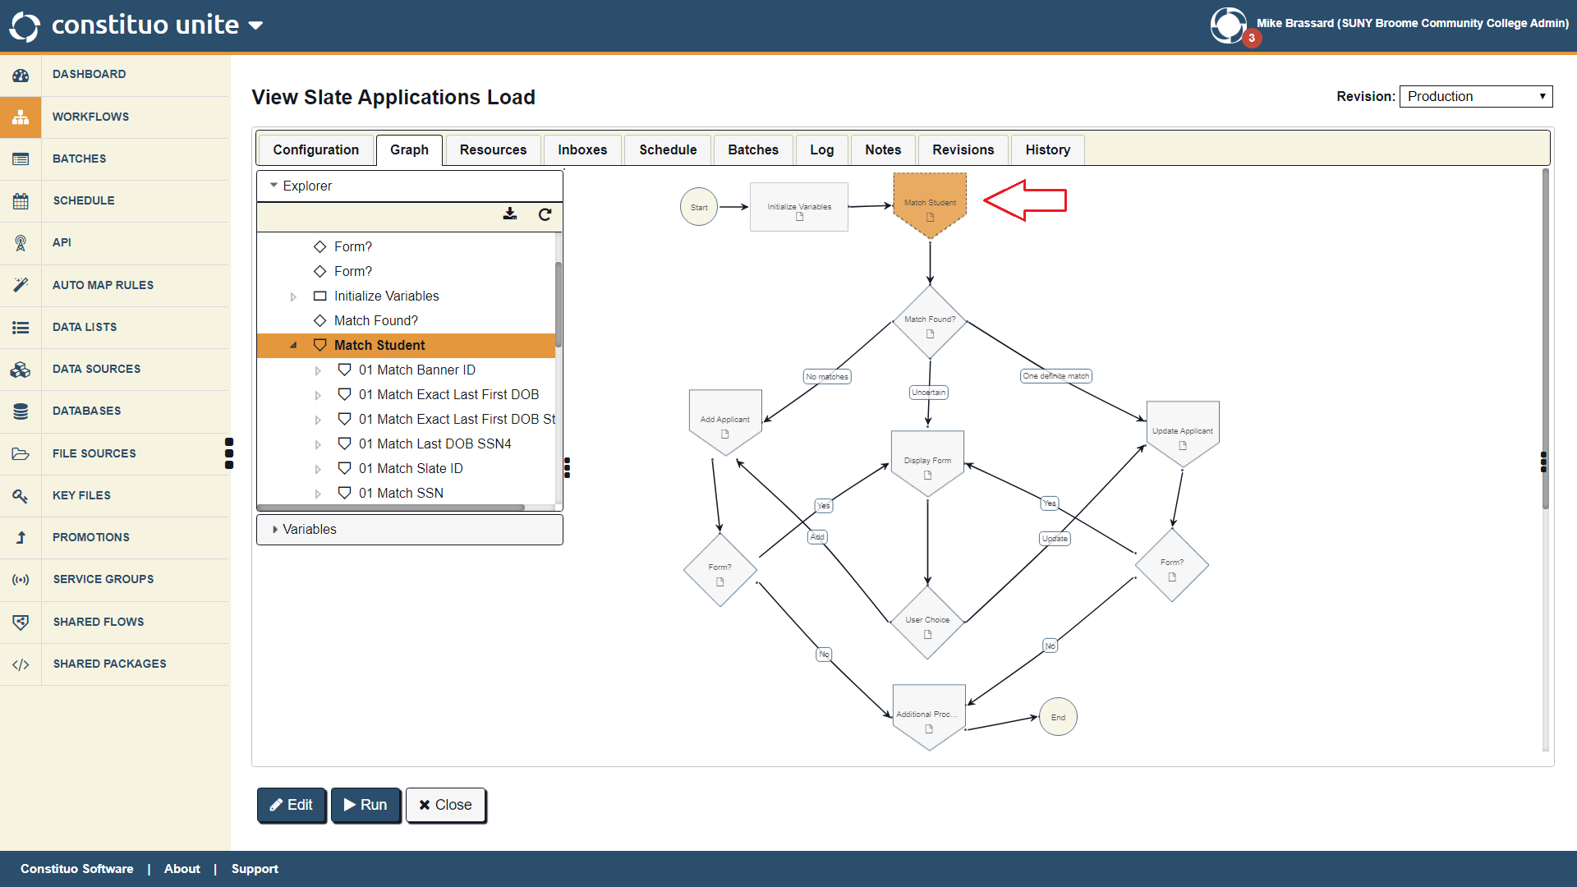

Slide 65
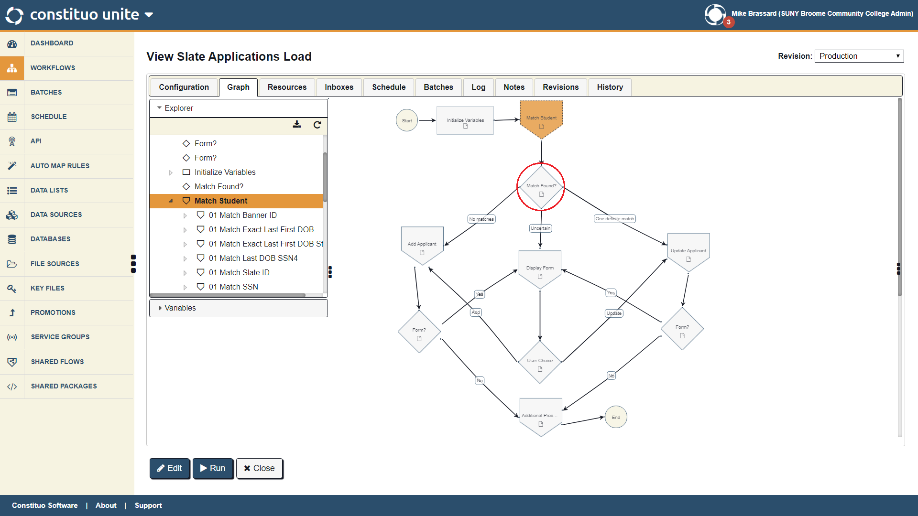

Slide 66
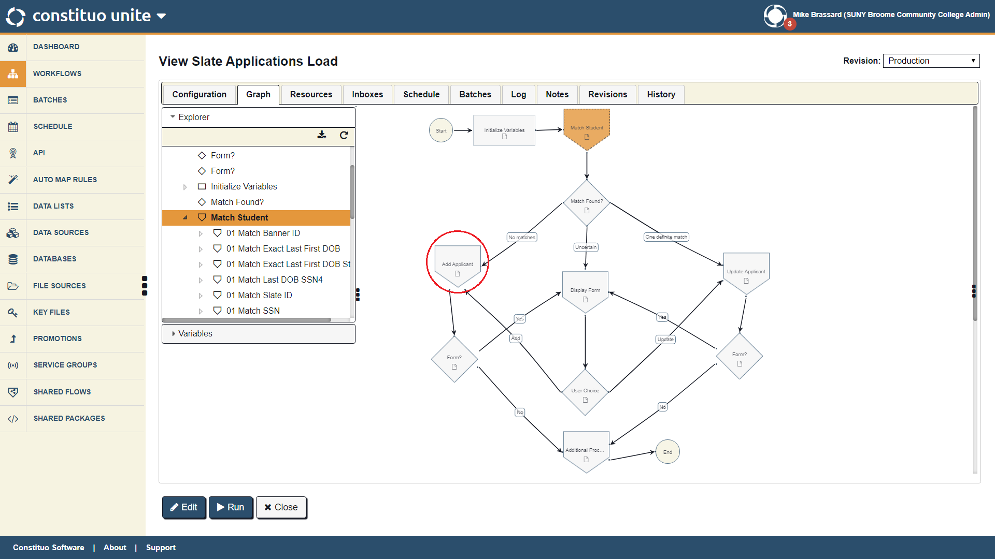

Slide 67
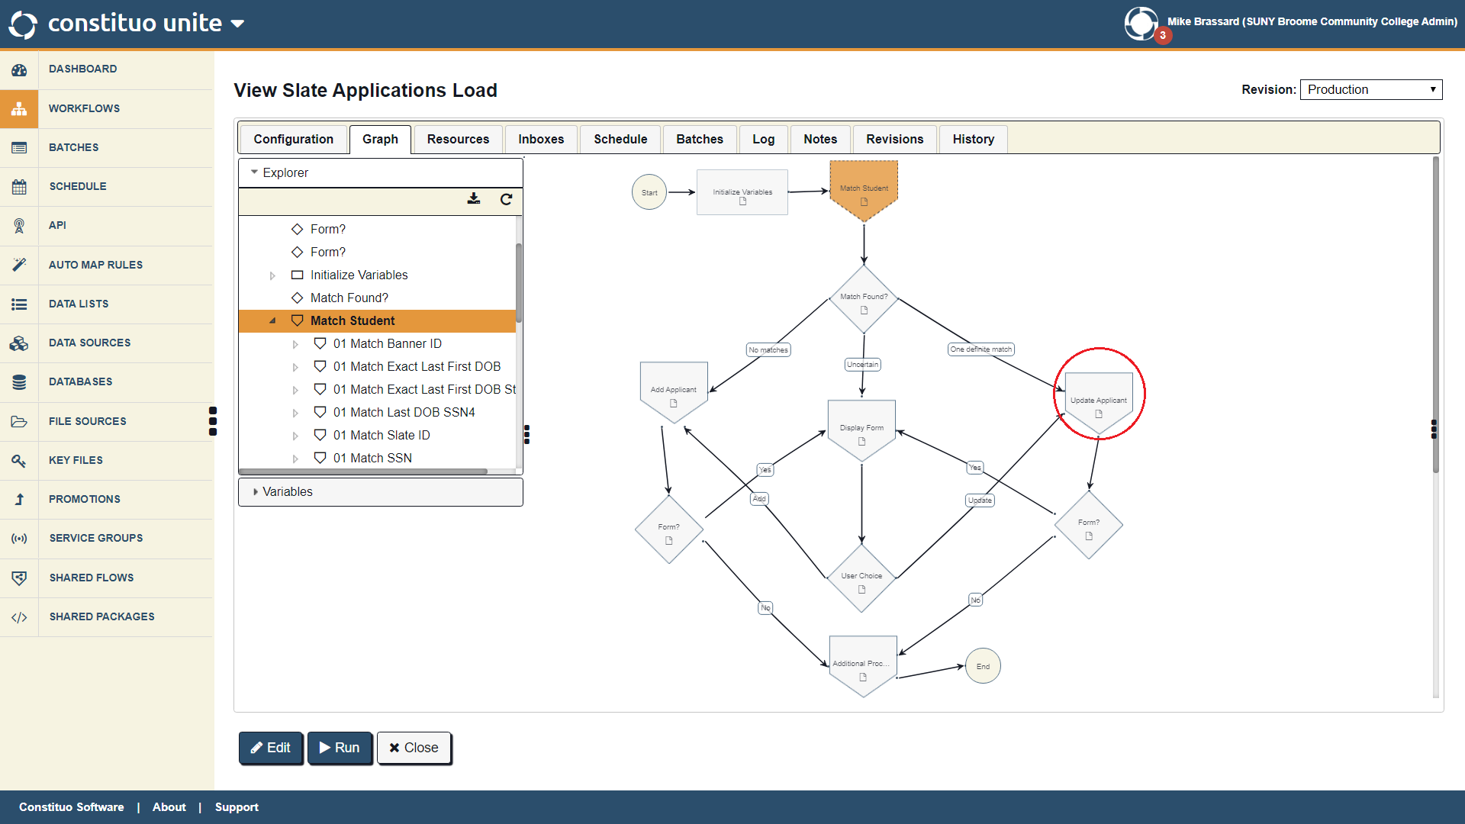

Slide 68
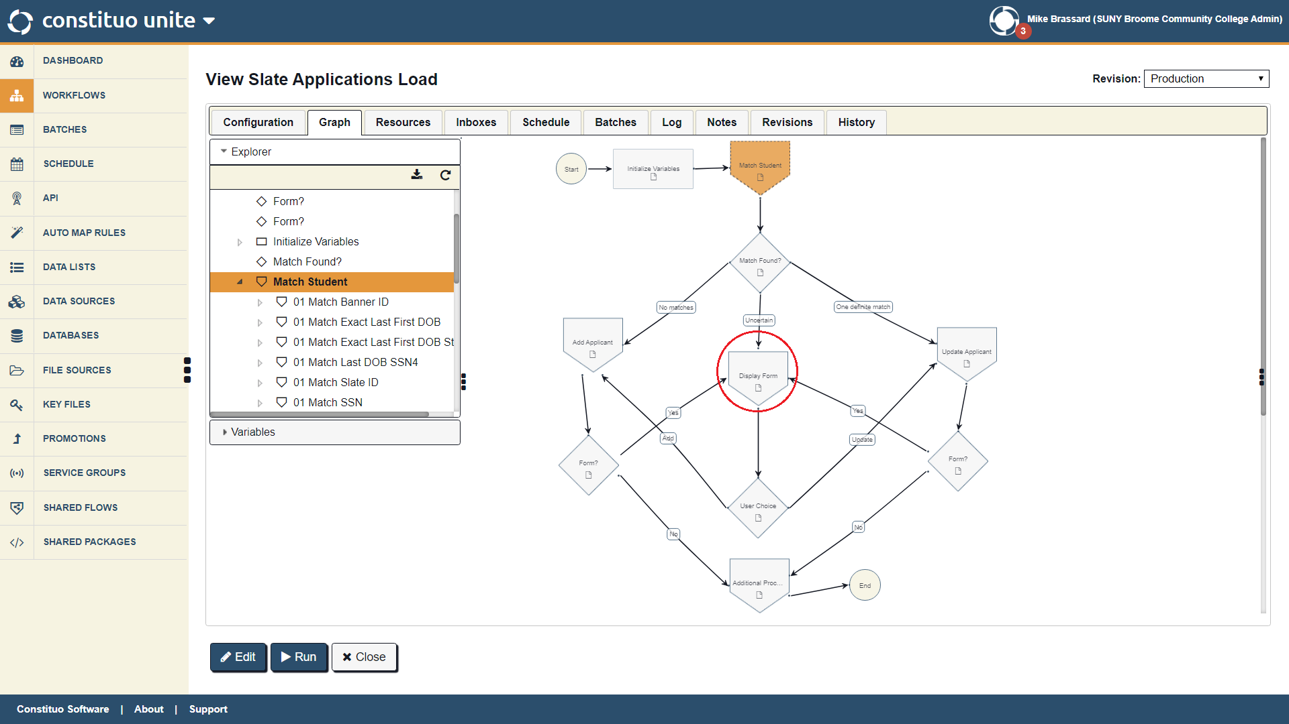

Slide 70
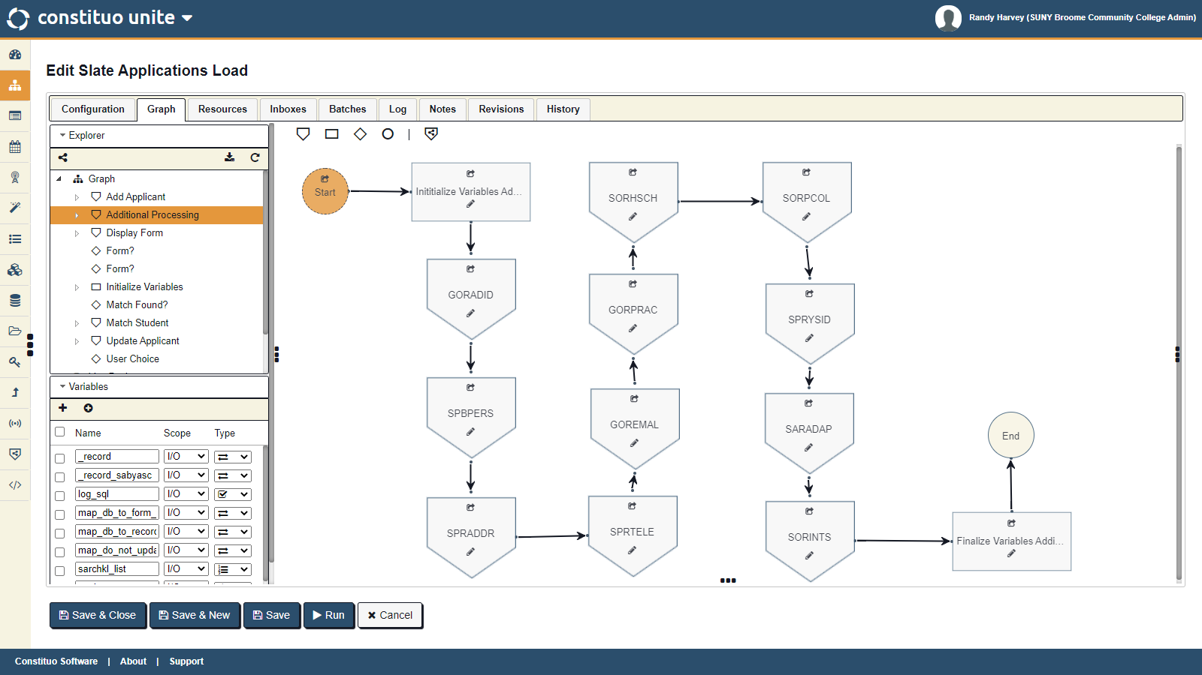

Slide 71
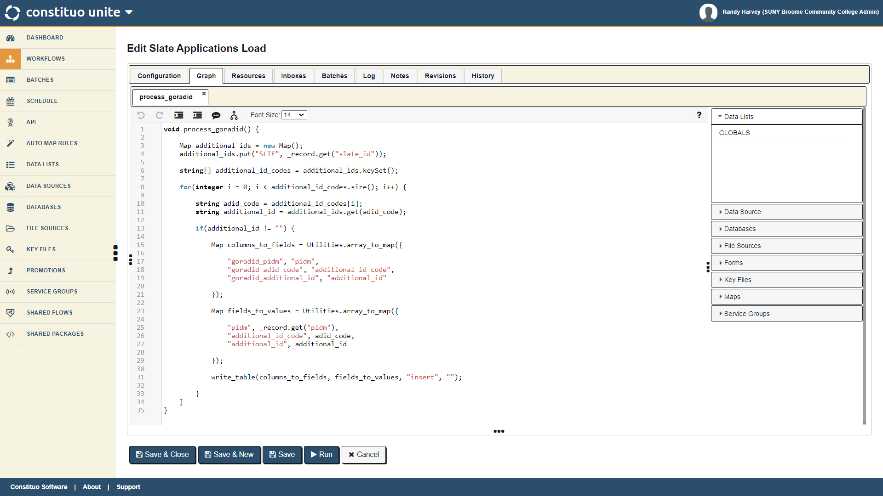

Slide 72
Our Implementation
Slate / Constituo / Banner Integration
Data: Slate application data to be exported (Fields? - Prompts?)
Extract: Slate data via SFTP (API Available)
Transform: Data to prepare for upsert into Banner
Load: Data using robust matching to avoid duplicates
Remediate: Remedy suspended records with a flexible interface

Slide 73
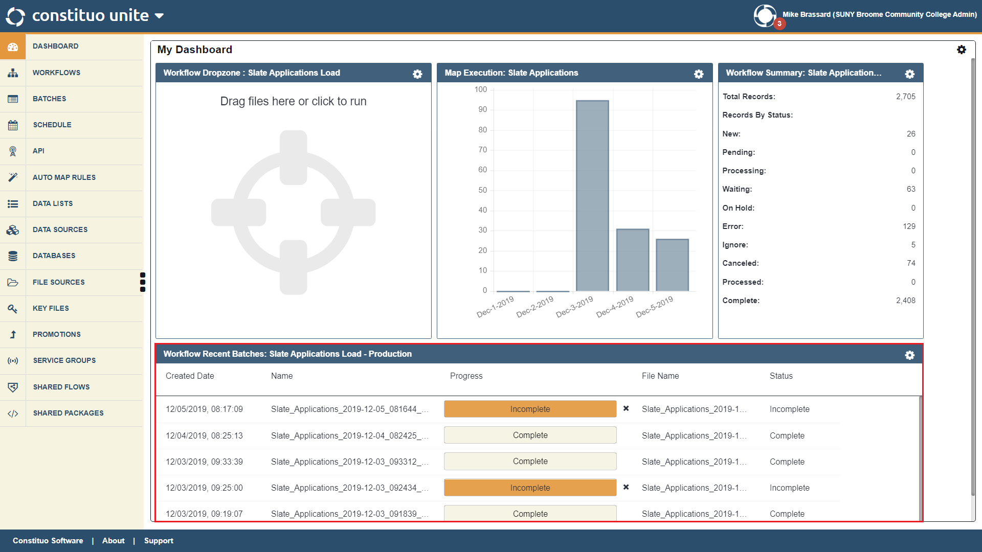

Slide 74
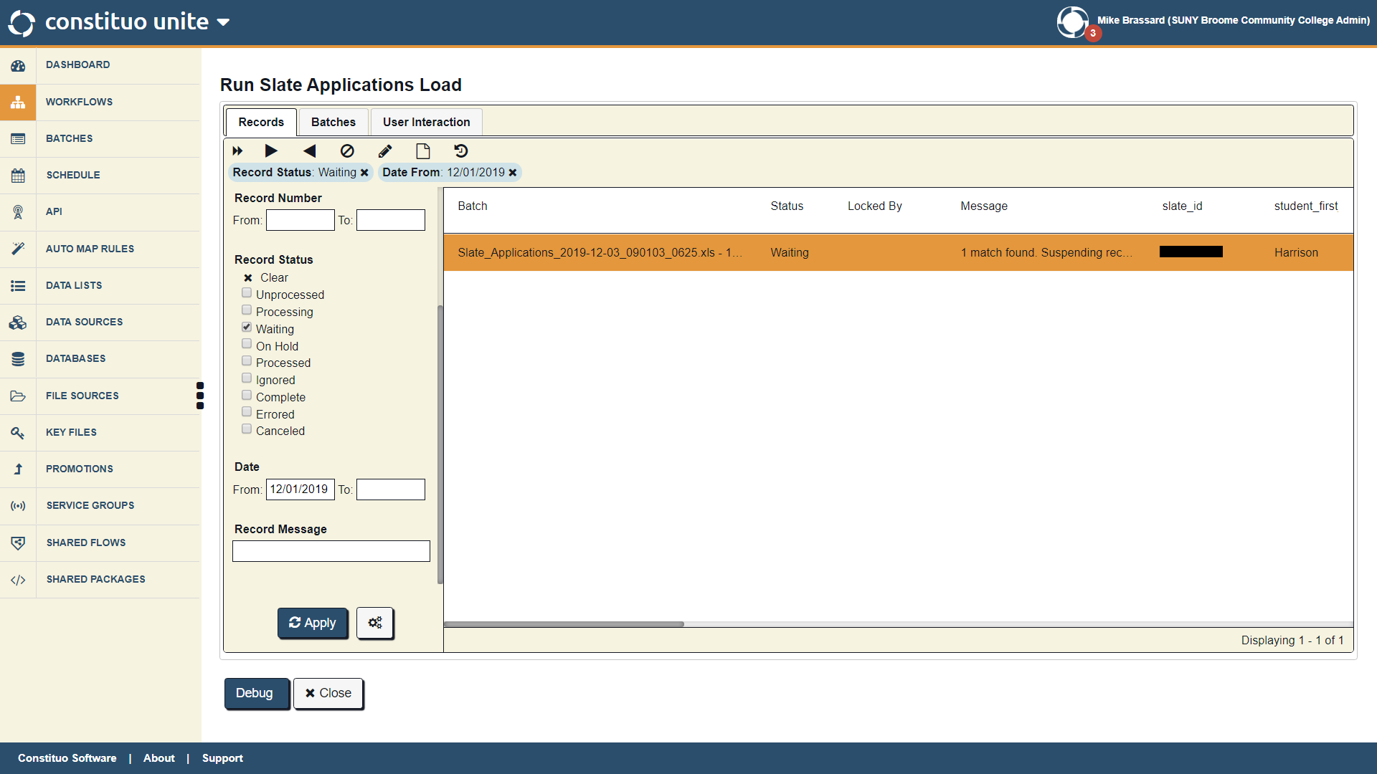

Slide 75
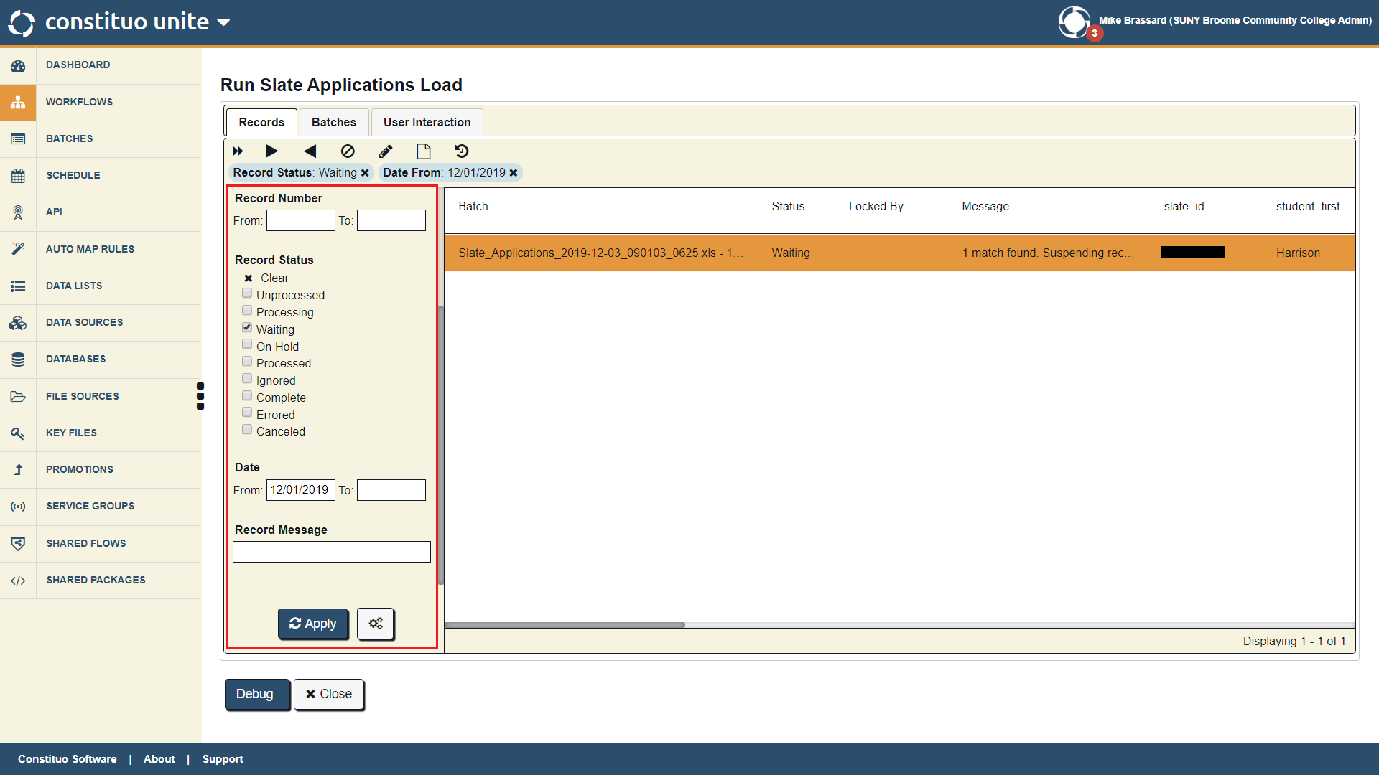

Slide 77
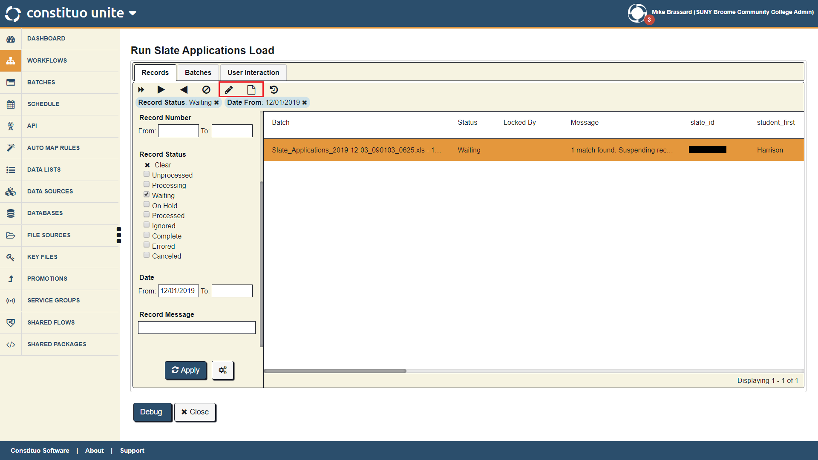

Slide 81
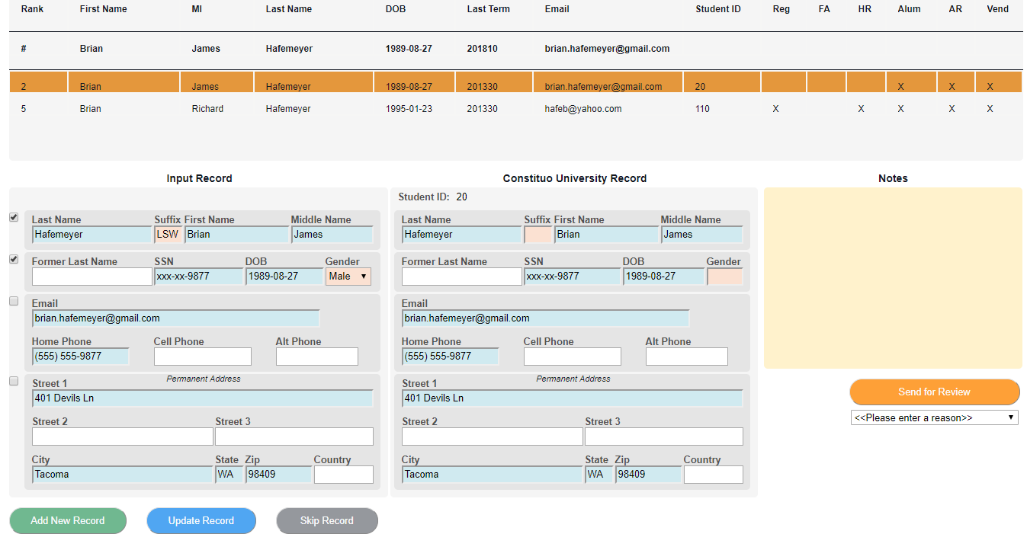

Slide 82
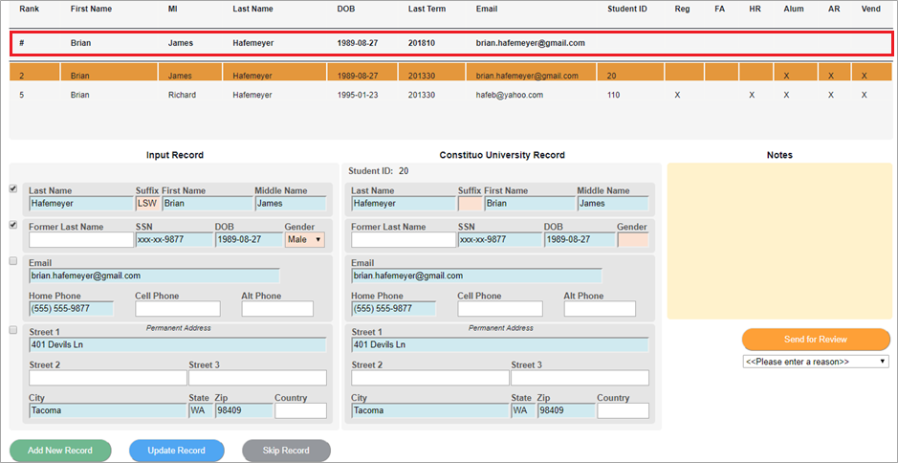

Slide 83
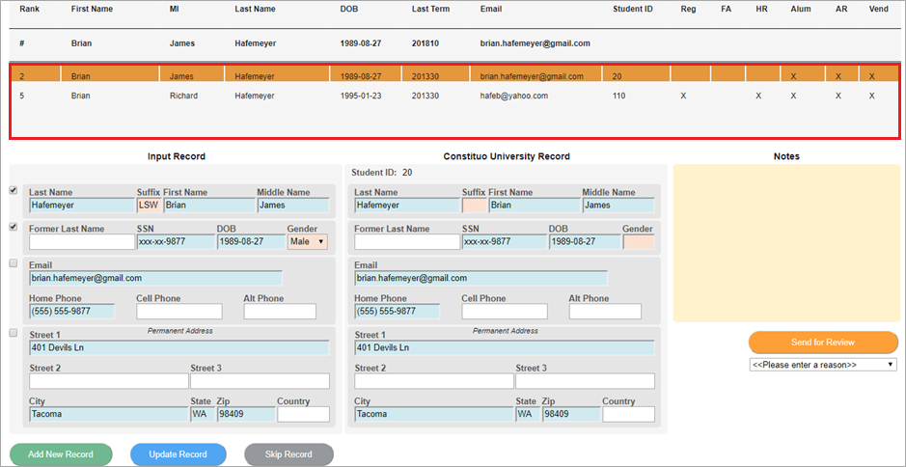

Slide 84
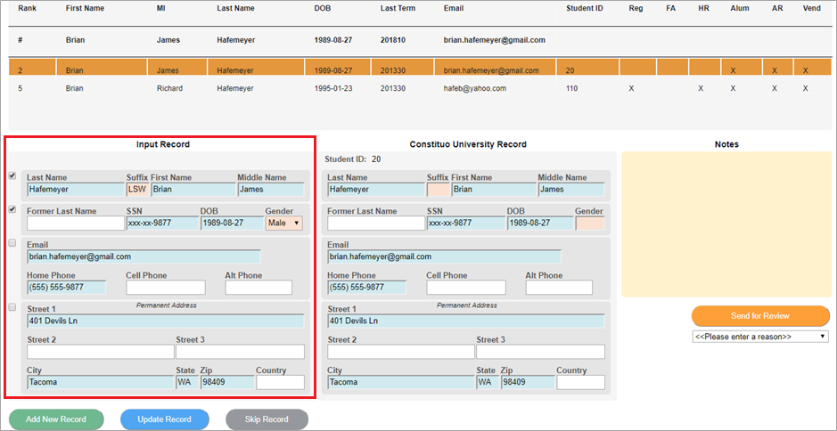

Slide 87
Our Implementation
Slate / Constituo / Banner Integration
Data: Slate application data to be exported (Fields? - Prompts?)
Extract: Slate data via SFTP (API Available)
Transform: Data to prepare for upsert into Banner
Load: Data using robust matching to avoid duplicates
Remediate: Remedy suspended records with a flexible interface
Standardization: Runner EDQ's CLEAN_Address

Slide 88
Why We’re Happy ☺
The Constituo Experience
Speed and success!
Software is great
Excellent Customer Service and Support

Slide 89
Slate / Banner Integration Solution
Bi-directional integration solution at $8K/year (w/ volume discounts) for three year contract
Slate to Banner (up to 225 fields)
Banner to Slate (up to 50 fields)
Professional service set-up fees waived
Unlimited standard technical support
Includes 10 hours of configuration services per year to address changes

Slide 90
Thank You!
Questions & Answers Contact Information
Scot Beekman - beekmansa@sunybroome.edu
Randy Harvey- harveyrm@sunybroome.edu Constituo Software (Joe Kirkland) - joseph.kirkland@constituosoftware.com

